Slide 1
CLASS OF 2025
SENIOR UPDATE
Notes:
Welcome Class of 2024 to your first Senior Guidance.

Slide 2

WHAT IS A SENIOR UPDATE?
College Visits
GPA Exemptions
Graduation Requirements
Missing Credits
Transcripts
Recommendation Letters
National Testing
Greenlight Locker
AND
Help in Making Your Future Plan
Explore the Senior Website
Notes:
Today we will be going over Senior information such as GPA Exemptions, Missing Credits, as well as exploring the Senior Website.

Slide 3
GRADUATION REQUIREMENTS
FOUNDATION PLAN 22 CREDITS
4 CREDITS ENGLISH
3 CREDITS MATH
3 CREDITS SCIENCE
3 CREDITS HISTORY
2 CREDITS FL
1 CREDIT PE
1 CREDIT FINE ART
5 CREDITS OF ELECTIVES
FOUNDATION DISTINGUISHED 26 CREDITS
4 CREDITS ENGLISH
4 CREDITS MATH (MUST INCLUDE ALG II)
4 CREDITS SCIENCE
3 CREDITS HISTORY
2 CREDITS FL
1 CREDIT PE
1 CREDIT FINE ART
7 CREDITS OF ELECTIVES (FOUR MUST BE TOWARDS AN ENDORSEMENT)
PASS ALL 5 STAR EOC TESTS: ENGLISH I, ENGLISH II, ALGEBRA I, BIOLOGY, US HISTORY
Notes:
In order to graduate you must have 4 years of English, 4 years of Math, including Algebra and Geometry, 4 years of Science including Biology and a Chemistry, and 3 years of History, including US HIstory, World History or World Geography, and Government/Economics. You also need 1 year of a Fine Art, 1 year of a PE, and 2 Years of the same foreign language. The rest of your credits will come from your endorsement and electives. If you are graduating on the Foundation 22 plan you will need 1 less math and science, and less electives.

Slide 4

ENDORSEMENT AREAS FOR THE 26 PLAN
STEM: must take Algebra II and Physics, plus four electives in engineering or computer science OR five courses in math or science
Business and Industry: must take four electives in business/industry, two of which must be from one of the following clusters: agriculture, architecture, arts/av/communications, business, finance, hospitality, information technology, manufacturing, marketing, transportation/logistics, language arts
Public Service: must take four electives in public services, two of which must be from one of the following clusters: health sciences, human services, law and public safety, education
Arts and Humanities: must take four electives in either Social Studies, foreign language, art, theatre, music or English
Multi-Disciplinary: must have four credits of all four core subject areas (including chemistry)
Notes:
You should already know your endorsement and have been working towards it the past 3 years. If you are needing information ask your counselor when you meet with them in a minute.

Slide 5

MISSING CREDITS?
Credit Recovery available during school or after school
Correspondence Course with Texas Tech
Credit By Exam
Notes:
If you are missing credits needed to graduate, Credit Recovery is available during or after school or you may pursue credit via a Credit by Exam, or Correspondence course. See your counselor for more information.

Slide 6
ADDITIONAL TESTING
SAT/ACT
TSI
National Tests designed to measure a student’s college readiness
SAT: Math, Reading and Writing (optional)
ACT: English, Math and Science
Must sign up online
Fee for testing unless on FRL
Retake as much as needed
Impacts college acceptance and scholarships
Test designed to measure readiness for college coursework
Tests Reading, Writing and Math
Does not impact college acceptance or scholarships
Required at all schools to determine what level of coursework is needed
Sign up online on senior canvas page or senior website and take here at AHS
Notes:
This year all Seniors will take the ACT during the school day. The TSI is offered during the school day several times this year for Seniors who need to take it, and if you are needing to take or retake the SAT, you will need to register on your own through College Board.

Slide 7
PERKS TO BEING A SENIOR
GPA Exemptions
11th & 12th graders (in their 3rd or 4th year of high school) with a GPA of 7.00 (80) or higher.
Only courses beyond the required graduation credits can be taken GPA exempt.
Only two courses per semester can be taken GPA exempt.
Numeric grades will show on the transcript but won’t be calculated in the GPA
Students must complete a GPA exempt form within the first three weeks of each semester. The decision is final and cannot be rescinded.
College Visits
Every senior can have one excused absence each semester to go and visit a college
Students must pick up a form from their attendance clerk for the college to fill out
Try to make a college visit day count! Plan to visit more than one in a day by mapping it out!

Slide 8

WHAT SHOULD I DO AFTER HIGH SCHOOL
What Should I Do After High School?

Slide 9
POSSIBILITIES……
WORKFORCE DEVELOPMENT
TRADE SCHOOLS
Programs that help train you for a job in a certain field such as Business, Entrepreneurship, Healthcare and Information Tech. Often free or low cost if you qualify.
App Process: Fill out online application and set up an appointment. For more information:
Workforce Solutions
TCC Workforce Solution Programs
Trade schools offer specialized coursework that teaches specific skills such as HVAC, Electrical, Automotive, etc.
App Process: applications are available at each individual trade school website. Students will need a copy of their transcript. Can be high in cost, but financial aid is available. For more information:
Trade School Options

Slide 10
MORE POSSIBILITIES
APPRENTICESHIPS
CERTIFICATION
An apprenticeships is the process of learning a skilled occupation through paid on the job training under a trained professional.
App process: Find the apprenticeships and then each has its own application process. For more information:
Texas Workforce Commision Apprenticeships
TCC Apprenticeship Programs
Certifications are credentials that you earn in to show you have a specific skill such surgical tech, web developer, pipefitter, etc. Usually done through a 2 year college or trade school.
App Process: apply to the program through the website.
TCC Workforce Certifications

Slide 11
AND EVEN MORE POSSIBILITIES
COMMUNITY COLLEGE
FOUR YEAR UNIVERSITIES
Two year schools that provide postsecondary programs from certifications to pathways to four year degrees. More affordable, accept all financial aid. Such as TCC, Navarro,
App Process: apply online at applytexas
For a list of all community colleges in Texas: Information for TCC and what they offer:
Texas Association of Community Colleges
TCC Academic Programs
Four year universities offer a full bachelors degree. These are degrees required for certain careers such as law, medicine, teaching, engineering, etc.
App Process: in Texas use applytexas, for out of state schools check the school’s website for application process.
College for All Texans
Apply Texas

Slide 12
HOW DO I GET THE FORMS I NEED TO APPLY:
TRANSCRIPTS
RECOMMENDATION LETTERS
Transcripts must be ordered online at
Transcript Ordering
Two types of transcripts: official and unofficial. All applications will require an official. Scholarships and others will specify if they need an official or unofficial.
Transcripts CANNOT be printed and handed to you. They must be ordered online.
Recommendation letters are letters written for you to submit as a quality reference for yourself. They can be written by teachers, family adult friends, counselors, administrators, etc.
You should always give a recommender at least a week to write you a letter
Provide a resume to anyone you ask to write you a letter or you may use this form.

Slide 13

HOW DO I PAY FOR ALL THIS?
There are four main ways to pay for post secondary plans:
FAFSA/TAFSA
Student Loans
Scholarships
Personal Savings

Slide 14


Free/Reduced Lunch
If you qualify for Free/Reduced Lunch you will be eligible for fee waivers to cover the cost of SAT/ACT and college waivers.
Go to AISD.net
Departments
Food and Nutrition

Slide 15
FAFSA/TAFSA, WHICH ONE???
FAFSA
TAFSA
Free Application for Federal Student Aid
Apply online starting December 1st
Must have parent/guardians most recent tax returns
Qualifies a student for scholarships, the Pell Grant, Student Loans and Work Study
Must be a US Citizen or eligible non-citizen and are enrolled in an eligible degree or certificate program.
Texas Application for State Financial Aid
Apply online starting December 1st, application must be printed and sent to the financial aid office of the institution you are planning on attending.
Qualifies students for scholarships and state financial aid.
Used for students who are classified as Texas Residents who are not eligible for Federal Financial Aid.
FOR THE BEST INFORMATION ON FINANCIAL AID VISIT College For All Texans

Slide 16
STUDENT LOANS AND SCHOLARSHIPS
STUDENT LOANS
SCHOLARSHIPS
Student Loans is money that the government will loan a student based upon the FAFSA results to help pay for school. The money must be paid back after a student graduates.
Scholarships can be given by the college/institution, private organizations or athletics. Where can I find them?
AHS Monthly Scholarship Bulletin
AISD Scholarship Website
School Soup Website
Raise Me
MOST STUDENTS PAY FOR COLLEGE WITH A COMBINATION OF MONEY FROM ALL OF THESE

Slide 17

I NEED HELP!!!
GO CENTER
The Go Center is located in Main Counseling Office
They can help with:
Applications
FAFSA/TAFSA/Scholarships
Resume Building
Essay Writing
And so much more!!!!

Slide 18
DATES TO REMEMBER
September 11 ASVAB Testing
September 19 AISD College Fair 6p-8p at UTA Maverick Center
October 1st ACT Testing
October 3rd Panoramic Picture 7:45am and Cap/Gown Meeting Café
Cookie Dough Fundraiser
Senior Parent Night 6pm
December 3 FASFA Night at 6pm
TBA Cap and Gown Orders due during lunch
November 11 ASVAB Testing
December 19-20 Final Exams
April TBA Prom Ticket Sales
May 15th Senior Awards
TBA Senior Prom

Slide 19

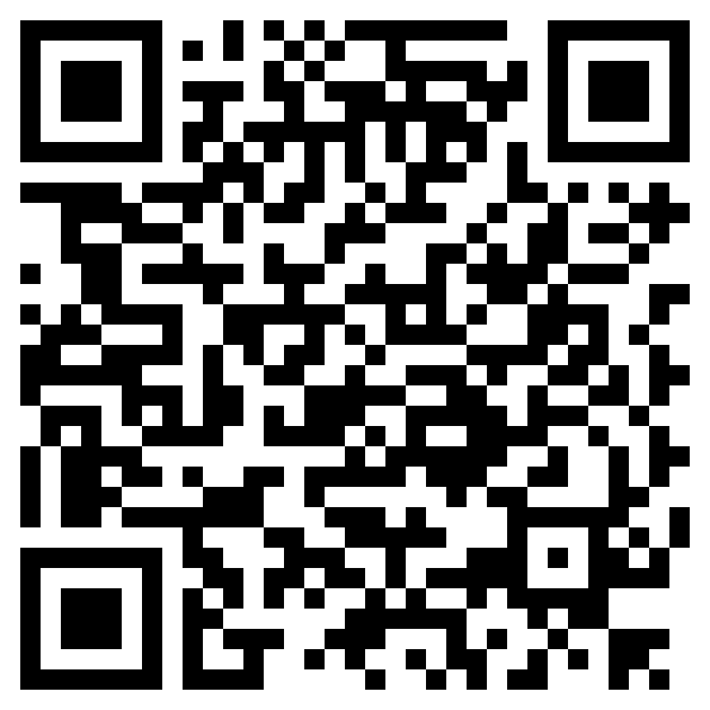
FOLLOW US FOR UPDATES
Facebook
AhsCounseling
Instagram
Counselingcolts
X
Counselingcolts
Senior Webpage

Slide 20
Each of you will meet individually with your counselor to discuss your grad plans, talk about your plans for after high school and discuss any questions you have. While you are waiting for you turn, you can do the following:
Use the Green sheets to create your Greenlight account, or if you already have an account, go to step 4 on the green sheets to link your account.

Slide 21
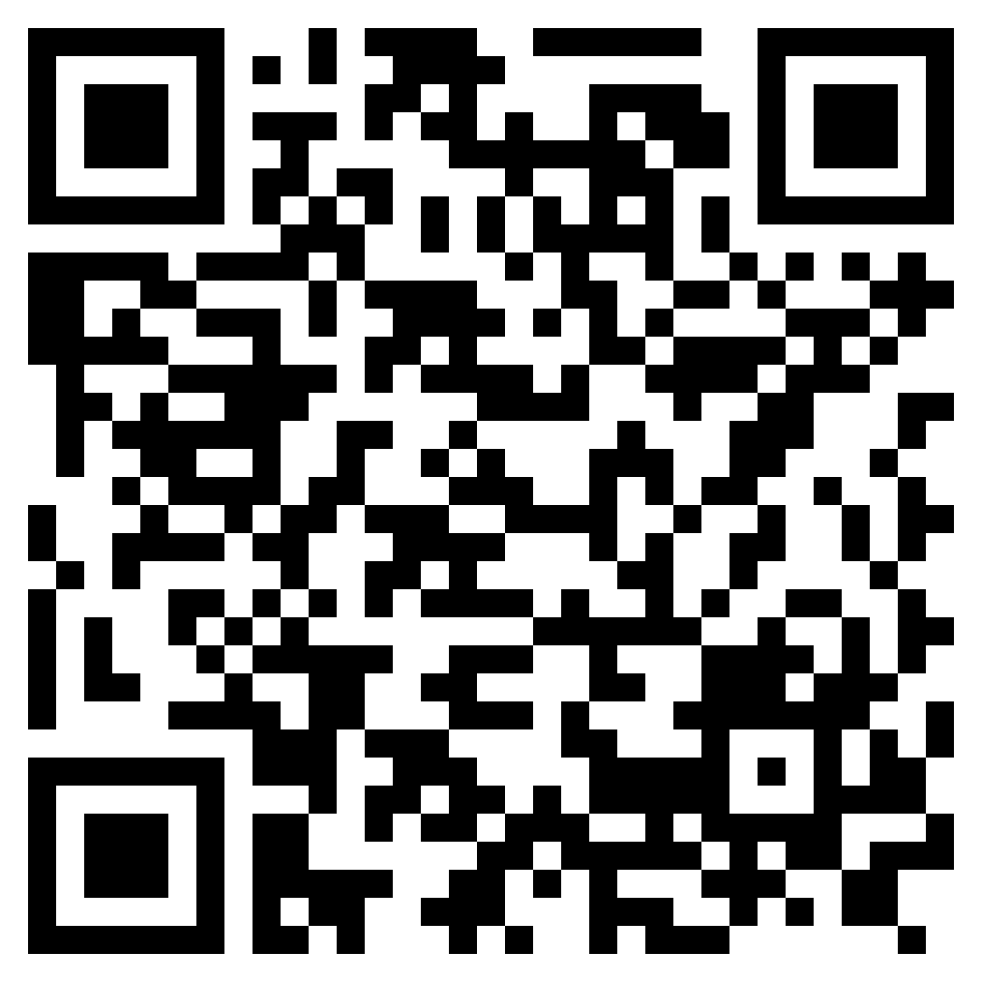
TO DO
Use the Senior Website to help you
Get an FSA ID for your FAFSA at Senior Padlet
Make an account on Apply Texas
Register for the SAT
Register for the ACT
Register for the TSI
Search for scholarships at School Soup
Research FAFSA/TAFSA at College for All Texans

Slide 22



Slide 23
Before you Start!
YES
Are you enrolled at Dallas College?
NO
Let’s Go
Have you earned a Dallas College transcript?
Stop Here
YES
NO

Slide 24

If you have earned TCB certifications or have taken dual credit courses through Dallas College, NCTC or UNTC, you may already have a GreenLight Locker.
Do not create another locker until you have confirmed you do not already have a locker.
Go to https://greenlightlocker.com/register and click “Register”.

Slide 25
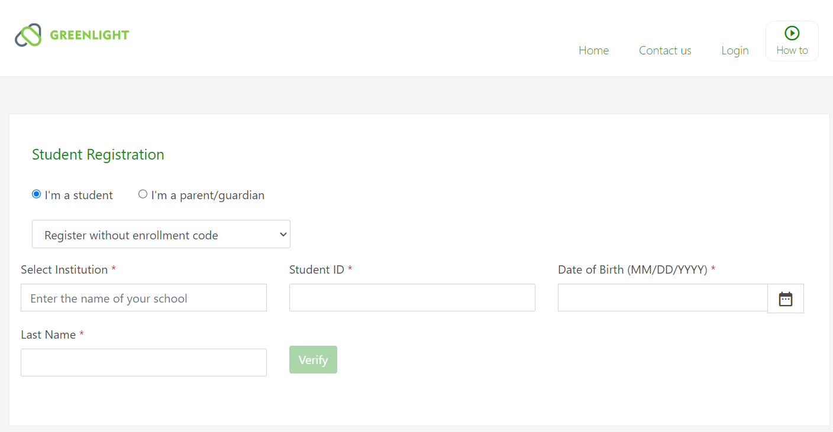
REGISTRATION – Without Enrollment Code
Default “I’m a student” and “Register without enrollment code”
Select Institution - begin typing your school district. Select your school district from the dropdown.
Enter your student ID, date of birth and last name. If you have two last names, be sure to enter them as it appears in your school record.
Click “Verify”

Slide 26
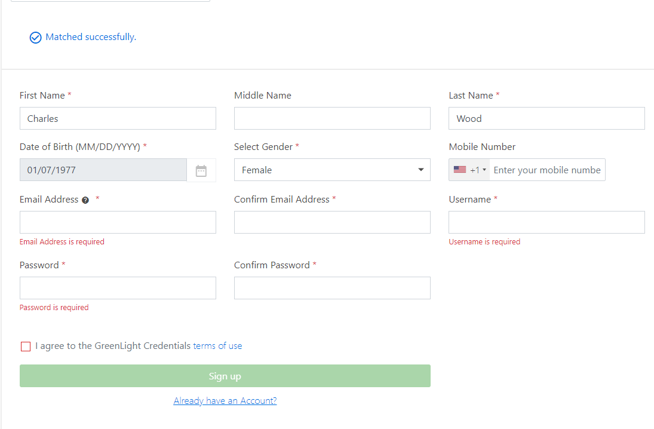
REGISTRATION – Complete Enrollment
After entering the correct information and clicking “Verify”, you should receive a “Matched successfully” response.
Complete all required fields, check the ‘I agree …’ box, and click “Sign up”.
Note: The password must be at least 12 characters - upper/lower case, special character, and numeric.

Slide 27
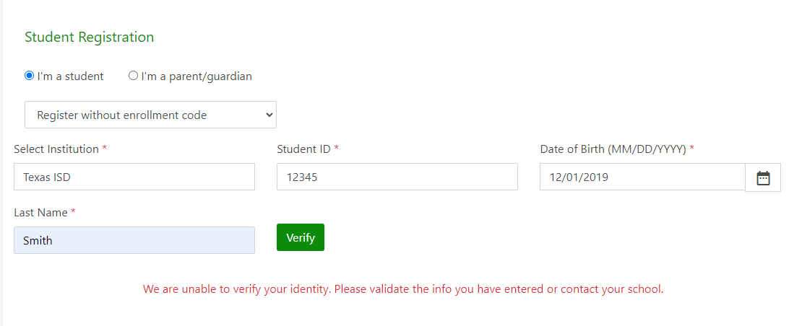
REGISTRATION – No Match Found
If you did not achieve a successful match, either the information entered is not a match with the information provided by your school district – or – you have already created a locker using your enrollment code.
If you are unsure what name and date of birth is in your school records, please contact your counselor.
If you cannot register with your school district transcript, click the ‘Contact Us’ link at the top of the screen. Complete the form and include your student ID, date of birth and school district in the message. Be sure to explain that you have tried to register but have been unable to us the ‘Register without enrollment code’ method.

Slide 28
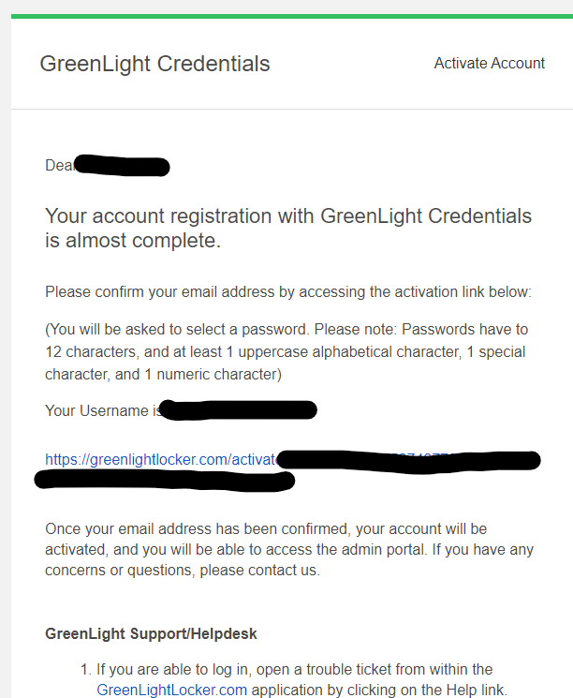
REGISTRATION – Activate Your Account
You are almost ready.
Once your registration is complete, an email will be sent to the email address provided during registration.
Find the activation email sent by GreenLight Locker. Activate the account by clicking on the link in the email.
If you don’t see the email, check your spam folder as unknown emails sometimes will be sent to spam.
If you don’t find the activation email, there is likely an issue with the email address. Click the Contact Us link in GreenLight for support.

Slide 29
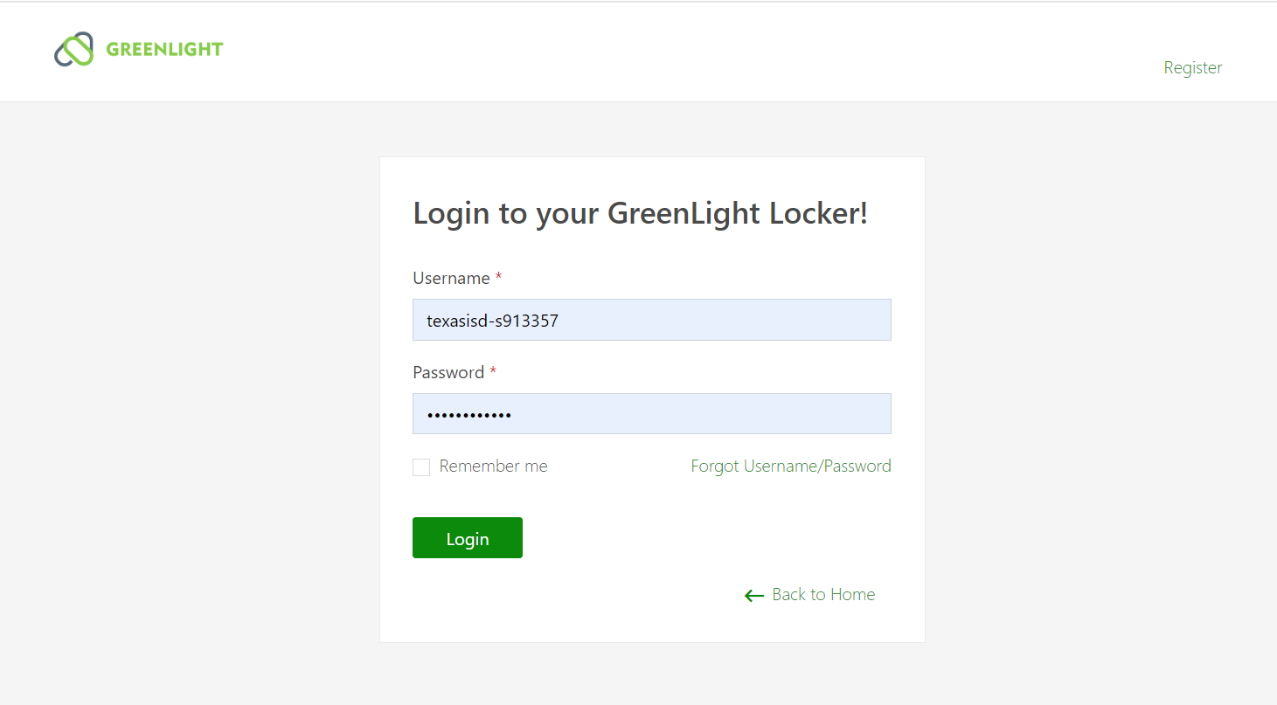
LOGGING IN
After activating your account, or if you already have an account, log in using the Username and Password created at the time of registration.
If you cannot remember your username or password, click the Forgot Username/Password link and follow the instructions.
To use the Forgot Username/Password help, you will need to know the email address used to create your account. If you cannot remember your email address, click ‘Back to Home’ and follow the ‘Contact Us’ path. Complete the form and include your student ID, date of birth and school district in the message. Be sure to explain that you cannot remember your email address.

Slide 30
Helpful Resources
Video Resources
Written Resources
1.
Parent Permission
GreenLight Credentials Wallet App
Updating Your Locker Profile & Preferences.pdf
Click Sheets for Students
Student Kick-off Presentation
GreenLight Credentials Wallet - Mobile App
2.
3.
4.
5.
SLIDESMANIA.COM

