Slide 1
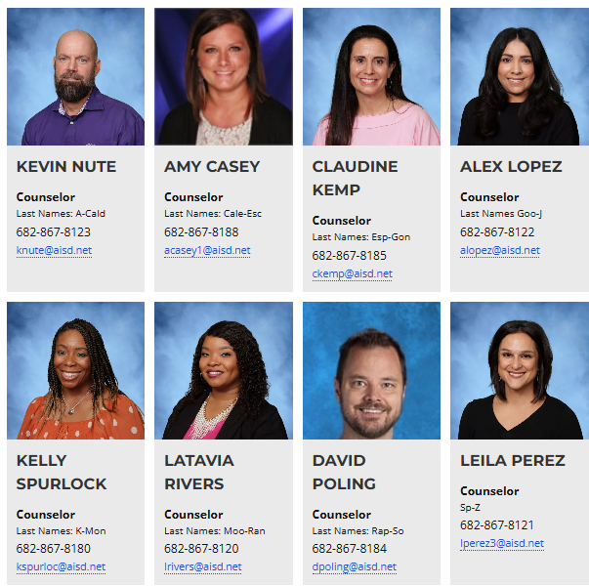
COUNSELORS
NEED TO SEE YOUR COUNSELOR?
Email
Come by the office during passing periods and sign into computer (tardies will not be excused for class)
Ask teacher to come see us during class with a pass.
Use this Tiny URL https://forms.gle/Bpkypy5vWAKobaK3A
Schedule change requests will be granted if :
Dropping a sport or extra curricular activity
A CTC/AG/CVPA class
ALL CHANGES must be made by September 4th
Adv/AP class drops start with your teacher
Dropping Adv/AP must be done by October 31, 2025

