Slide 1
Citizens’ Bond Oversite Committee
Arlington ISD 2014 Bond Program
Interim Update to Board of Trustees
17 August 2017

Slide 2
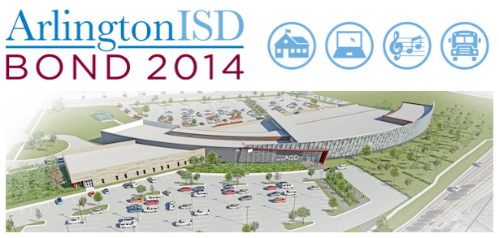
Agenda
Purpose
Composition
Meeting Schedule
CBOC Charge
Recommendations
Special Thanks

Slide 3
Purpose
The Citizens Bond Oversight Committee (“Committee”) is established to provide transparency and enhance public confidence in the use of proceeds from the sale of bonds authorized by Arlington Independent School District (“AISD” or “District”) voters on May 10, 2014.
The purpose of the Committee is to provide findings and recommendations to the Board of Trustees (“Board”) relating to the expenditure of bond proceeds authorized in the 2014 Bond election, the progress of the 2014 Bond Program, and ways the District can maximize the potential of the 2014 Bond Program.

Slide 4
Composition
Members (11)
Alternates (6)
William Deakyne (chair)
Rebecca Deen
Cara Hackley
H. Suzanne Kelley
Andrew Nash
Wendy Parker
Lori Plamondon
Seth Ressl
John Slover
Ismail Tahir
David Wilbanks
Stephen Crumby
Bill Huff
Wesley Maness
Kimberly Martinez
Cynthia Miller
Steve Rothwell
Accountants
Voters
Realtor
Law Enforcement
Higher Education
Sales & Marketing
Former Students
Tax Payers
Engineering & Manufacturing
K-12 Education
City Management
Veterans
Parents of Students
Internet Technology

Slide 5
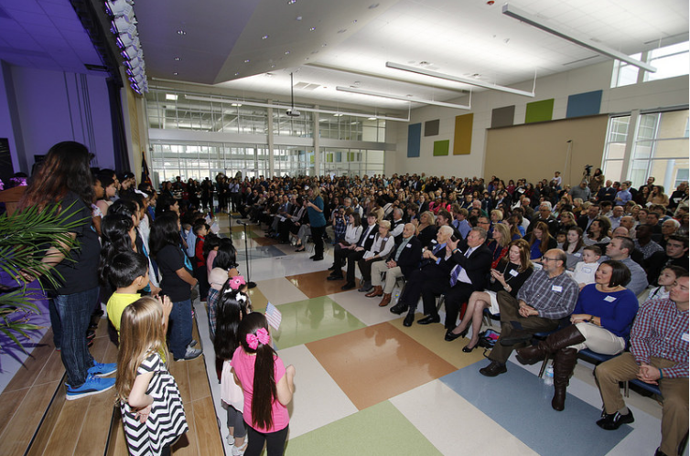
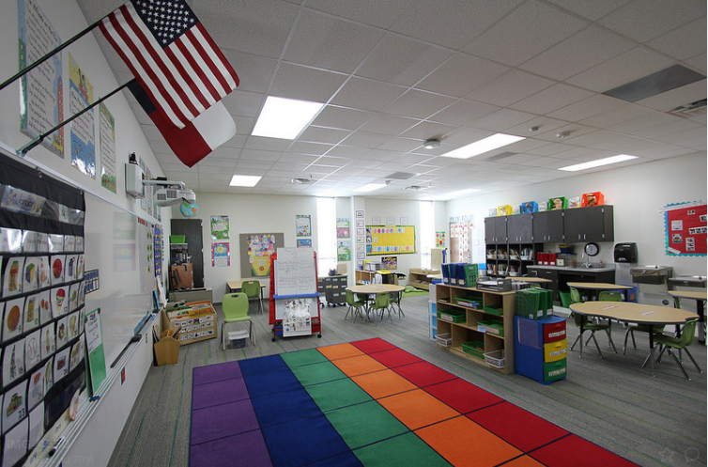
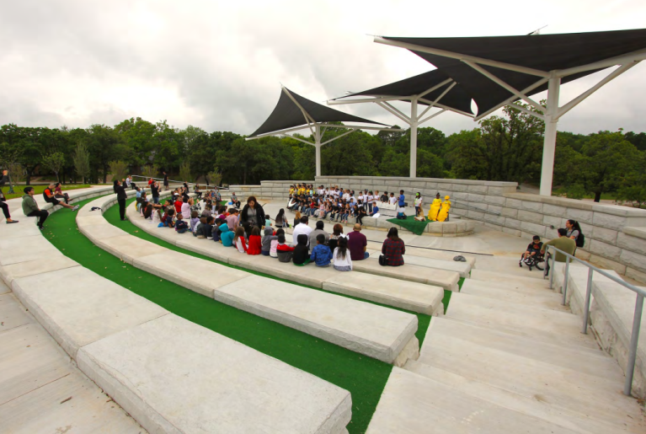
Meeting Schedule
October 12, 2016 - Orientation for new members, Location: PDC
October 26, 2016 - Quarterly Meeting, Location: McNutt Elementary
January 18, 2017 - Quarterly Meeting, Location: Peach Elementary
April 26, 2017 - Quarterly Meeting, Location: Jones Academy
August 9, 2017 – Committee Meeting, Location: PDC

Slide 6
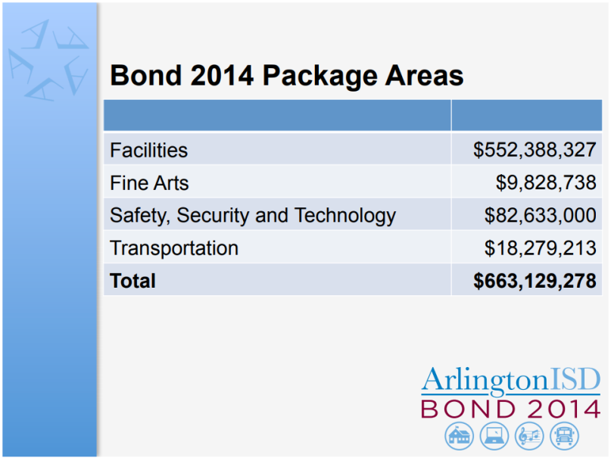
CBOC Charge (1 of 11)
Review the January 2014 report submitted to the Board by the 2013-14 Capital Needs Steering Committee to gain an understanding of the projects and capital needs recommended for inclusion in the 2014 Bond Program.
Observation:
AISD Staff briefed bond scope
Bond Package Areas linked to Strategic Objectives
Recommendation:
Continue orientation methodology for future committees by AISD Staff

Slide 7
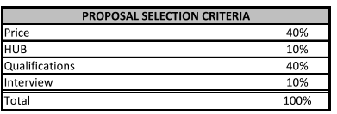
CBOC Charge (2 of 11)
Review the process used to solicit, qualify, and select design professionals, contractors, and vendors for projects funded from the 2014 Bond Program.
Observation:
Request for Quote and Bidding process explained
Examples of in-stride re-bidding process explained
Recommendation:
Continue to utilize the appropriate contractual tools to motivate contractor performance

Slide 8
CBOC Charge (3 of 11)
Review reports on the current status and planned implementation of the 2014 bond program to determine whether such status and implementation are consistent with the Bond Program approved by the voters.
Observation:
Facility construction efforts appear consistent with the bond’s intent
Fine Arts efforts appear consistent with bond’s intent
Safety, Security, and Technology efforts appear consistent with the bond’s intent
Transportation efforts appear consistent with the bond’s intent
Recommendation:
Success Metrics or Key Performance Indicators could be tied to demonstrate the intended effect at identified milestones

Slide 9
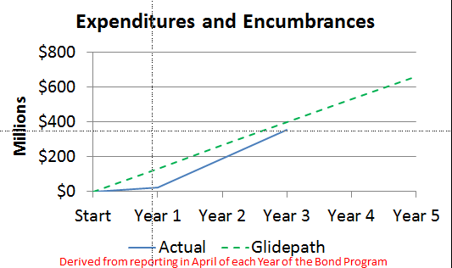
CBOC Charge (4 of 11)
Review bond program reports that track budgets, encumbrances, expenditures, and estimated costs for completion for each bond project.
Observation:
Rate of encumbrances and expenditures appear to be accelerating to meet bond schedule
Project timelines have shifted in order to facilitate cost advantages that delay some projects and accelerate others
Under performing contractors are addressed by AISD Staff and project re-bids impact timeline
Recommendation:
Continue with current AISD Staff activities to track, monitor, and manage projects
Explore ways to publicly explain the wide array of tools available for contract enforcement in the contract management process

Slide 10
CBOC Charge (5 of 11)
Review HUB utilization on facilities projects.
Observation:
HUB participation as of April 2017 at approximately 18%
Previous CBOC Committee recommended a target of 20%
Recommendation:
Monitor HUB participation by vendors and their HUB participation track record when potentially awarding future contracts

Slide 11
CBOC Charge (6 of 11)
Review internal and external audits of the bond program to ensure the adequacy of scope, administration’s response to the audit, and remediation efforts of the district, as applicable.
Observation:
Internal Audits were underway and information will be made available to the CBOC in late August 2017
AISD Staff is working with an external audit service to identify projects for audits within the 2014 Bond Program
Recommendation:
Provide audit criteria for review by CBOC
Continue to provide CBOC with general explanations when contractors fail to perform

Slide 12
CBOC Charge (7 of 11)
Review and provide input on AISD communications to the public regarding the 2014 Bond Program.
Observation:
Marked improvement in dashboards
Project photos by location are useful
Provide avenues to specifically address concerns or frequently asked questions about project delays or changes potentially through the website, newsletters, targeted mailings, etc.
Recommendation:

Slide 13
CBOC Charge (8 of 11)
With the coordination of the Superintendent or Superintendent’s designee, conduct on-site campus and facility visits related to bond projects, as necessary, in a non-disruptive manner.
Observation:
Conducted group on-site visits of McNutt and Peach Elementary, and the Jones Academy
CBOC members conducted individual on-site visits: Butler Elementary, Duff Elementary, Arlington HS and Martin HS
Recommendation:
Group visits were focused on new-construction or significant remodel locations; conduct existing campus facility visits
Potentially increase program contingency budget allocations in future bond programs for schools upgrading existing equipment or facilities for areas such as building code compliance

Slide 14
CBOC Charge (9 of 11)
Agree by majority vote upon all findings and recommendations to be presented to the Board.
Observation:
CBOC Committee agreed by majority with the enclosed recommendations
When CBOC members were not present; their input was solicited through e-mail
Participation by Student (SLAB) Members was limited
Recommendation:
Re-assess the charge for SLAB member participation in order to expand student participation

Slide 15
CBOC Charge (10 of 11)
Provide reports to the Board semi-annually or more frequently, if necessary, on the implementation of the 2014 Bond Program and any findings and recommendations for corrective actions or adjustments to the Bond Program.
Observation:
Interim briefings to the Board on a semi-annual basis appear appropriate
Target date for spring briefing to the Board should be in the month of May
Include students in the report to the Board
Recommendations for adjustments:

Slide 16

CBOC Charge (11 of 11)
Coordinate with the Superintendent or the Superintendent’s designee to maintain a presence on the AISD website with a link on the AISD home page. The website shall timely provide the public with information regarding the Committee’s activities, including: meeting agendas and minutes; information, presentations and reports received from AISD staff; and meeting schedules of the Committee and all subcommittees.
Observation:
CBOC meeting materials are easily accessed from the AISD webpage
Photos, Financials, and Dashboards are easily accessed from the AISD webpage
Recommendation:
Continue with development of products such as the Dashboards that are easy to use interfaces for the community to gain information on specific projects and the general bond execution

Slide 17
Recommendations Summary (1 of 2)
Continue orientation methodology for future committees by AISD Staff
Continue to utilize the appropriate contractual tools to motivate contractor performance
Success Metrics or Key Performance Indicators could be tied to demonstrate the intended effect at identified milestones
Continue with current AISD Staff activities to track, monitor, and manage projects
Explore ways to publicly explain the wide array of tools available for contract enforcement in the contract management process
Monitor HUB participation by vendors and consider their HUB participation track record when potentially awarding future contracts
Provide audit criteria for review by CBOC
Continue to provide CBOC with general explanations when contractors fail to perform

Slide 18
Recommendations Summary (2 of 2)
Provide avenues to specifically address concerns or frequently asked questions about project delays or changes potentially through the website, newsletters, targeted mailings, etc.
Group visits were focused on new-construction or significant remodel locations; conduct existing campus facility visits
Potentially increase program contingency budget allocations in future bond programs for schools upgrading existing equipment or facilities for areas such as building code compliance
Re-assess the charge for SLAB member participation in order to expand student participation
Target date for spring briefing to the Board should be in the month of May
Include students in the report to the Board
Continue with development of products such as the Dashboards that are easy to use interfaces for the community to gain information on specific projects and the general bond execution

Slide 19
Special Thanks
Kecia Mays, Chair, Community Engagement Committee, Board of Trustees
Aaron Reich, President, Board of Trustees
Polly Walton, Board Member, Board of Trustees
Cindy Powell, Chief Financial Officer
Kelly Horn, Executive Director of Plant Services
Javier Fernandez, Director of Facility Planning and Construction
Chad Branum, Assistant Superintendent of Technology
Dr. Jeremy Earnhart, Fine Arts Director
Tim Collins, Director of Transportation
James Smith, Security Manager
Tony Drollinger, Executive Director of Finance
Craig Wright, Career Tech Coordinator
Ginger Polster, Career Tech Center Principal

Slide 20
Derived from reporting in April of each Year of the Bond Program

