Slide 1

Choosing
Classes
For
Next Year
Lamar High School

Slide 2
Registration for 2024-2025
Students should think about which classes they’d like to choose before they fill out the form located at the end of this presentation. This presentation will give you some guidance on how to do that.
Now is the time to get permission for LHS specialty classes (ex: Yearbook, Newspaper, etc.) or to complete applications for special programs.
Don’t worry if you don’t have it all figured out; your counselor will be there to help you as you finalize your decisions. Just email them or use the QR code outside of the counseling office so they know to call you in!

Slide 3
Graduation requirements
Foundation High School Program
Distinguished Level of Achievement (26 credits)
*4 credits of English
*4 credits of Math (to include Algebra I, Geometry, and Algebra II)
*4 credits of Science (to include Biology and at least one of these: IPC, Chemistry, or Physics)
*3 credits of Social Studies (to include US History and Government and Economics and at least one of these: W. History, W. Geography, or AP Human Geography)
*2 credits of the same Foreign Language
*1 credit of PE
*1 credit of Fine Arts
*7 credits of Electives
***at least 1 endorsement (received by taking a series
4 credits in the same career pathway)

Slide 4
Enrolling in specialty courses
What you need to know

Slide 5
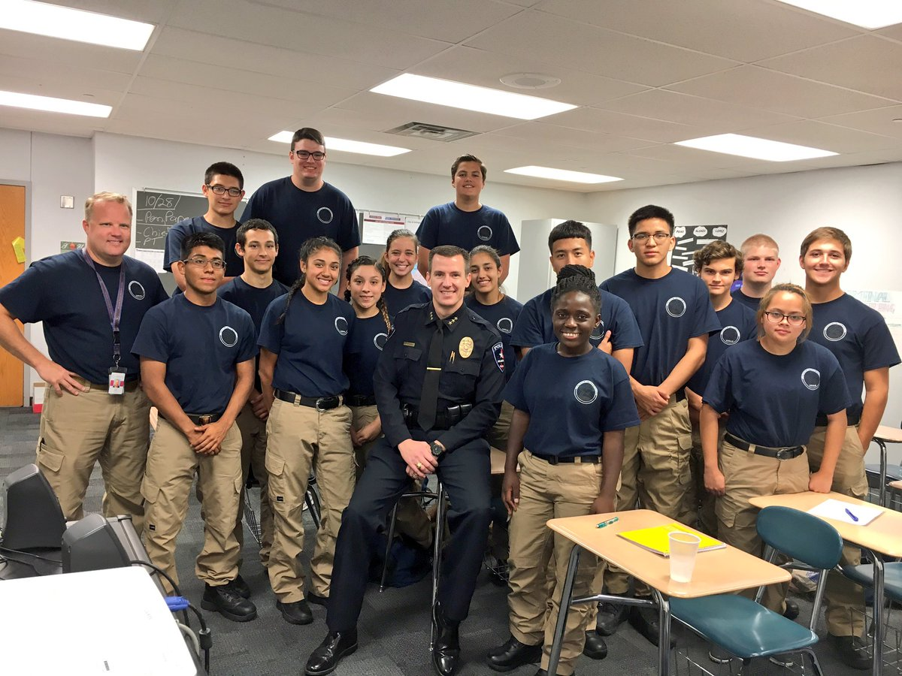
Specialty courses
Some classes and programs require an application. Most of the classes below are for juniors and seniors. However, the time is now to plan for them so that you take the appropriate prerequisite classes. See the AISD Course Description Handbook for more details about getting into these courses.
  Workforce and Academic Dual Credit courses
    Classes taught by TCC professors in
    which students earn college credit
  Fire Academy
  AISD Police Academy
  Cosmetology If you want the full Cosmetology Program
  Culinary Arts for junior/senior year, you should take
  Hospitality Intro. to Cosmetology 10th grade year!
  Construction Technology, Architecture
  Computer Technician
  Agriculture, Floral Design/Plant Science, Vet Assistant
  Instructional Practices (Teaching!)
  Health Science, Biomedical Science
  Law, Public Safety, Corrections, & Security The deadline to apply is usually mid-January of junior/senior year.
  Practicums in STEM – Engineering, Computer Science
  Practicum in Human Services
  Business & Finance; Marketing; Entrepreneurship; Manufacturing; Transportation
  Art & A/V Technology, and Communications; Video Game Design; Photography

Slide 6

How can I join AVID?
Advancement Via Individual Determination (AVID)
Must complete an application √
Must be interviewed √
Must have a 2.0-3.5 GPA √
Must want to go to college √
Must be in Advanced Classes √
Must have determination to be successful √
AVID application for current 9th and 10th graders ONLY:
No application available at this time. See Ms. Drake in room 287 for more information.

Slide 7

Specialty Courses
IB (International Baccalaureate) Classes
  IB has a comprehensive two-year curriculum based upon international standards in six subject areas that begins junior year.
  These classes are challenging and involve projects and community service.
  Students may earn college credits through successful completion of the IB program.
  You can’t start IB classes until junior year.

Slide 8

OnRamps
  UT (Austin) college credit upon successful completion of the course.
  Weighted credit!
  Course options:
  There are several courses offered here at Lamar High School and other AISD campuses.
  Ask your counselor for more details.

Slide 9

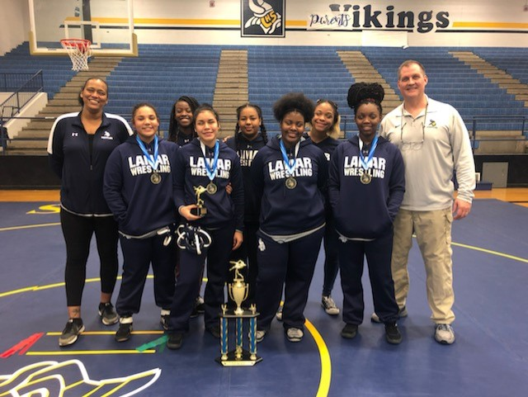


Specialty Courses
Some classes require try-outs or permission from the coach or teacher. Examples of these classes include athletics, cheerleading, drill team, newspaper, and yearbook.

Slide 10
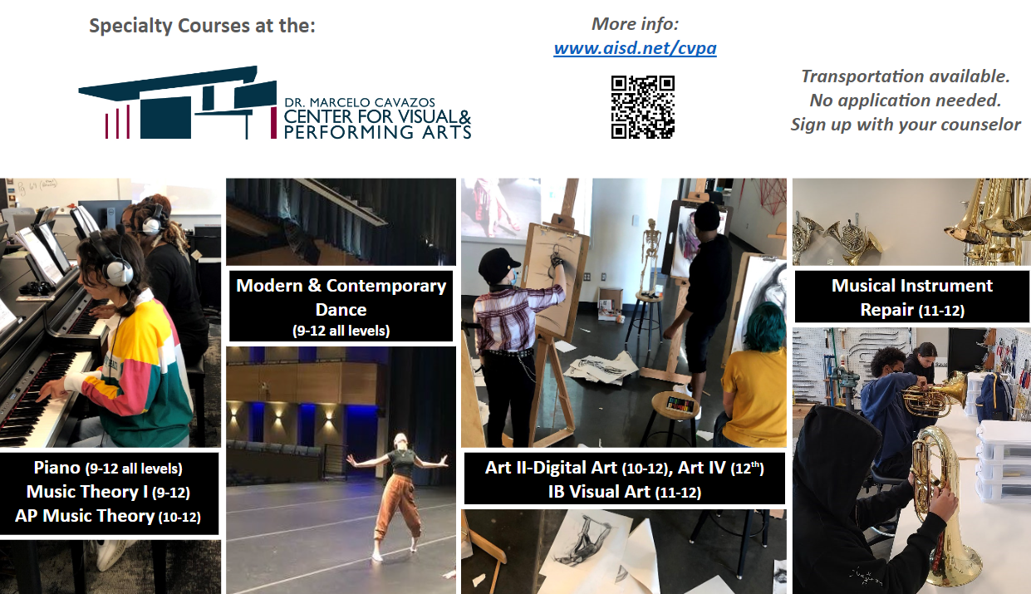

Slide 11
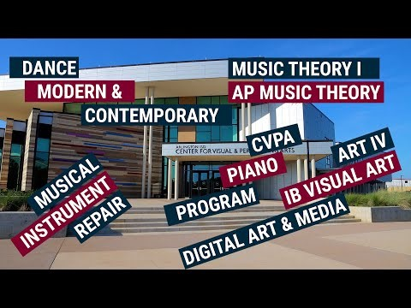
This is a video. Click the play icon once it loads. when it finishes, the slide will advance on its own.

Slide 12
Understanding the course selection sheet
On this page, each student will choose one class from English, Math, Science, and Social Studies.
    If you are going to be a sophomore:
      you will choose either English II regular or advanced.
      If you are in Algebra I, you will pick regular or advanced Geometry. If you are in Geometry, you will pick either regular or advanced Algebra II or OnRamps College Algebra. There are additional options for students currently enrolled in Algebra II.
      If you are in Biology, you will choose IPC (Integrated Physics and Chemistry) or Chemistry. If you feel comfortable with Math and Science, Chemistry (either regular or advanced) is the recommended class. If you are in Chemistry this year, you will have additional options listed on the sheet.
      You will choose World History of AP World History. For other Social Studies options, you will need to consult with your counselor.

Slide 13
Understanding the course selection sheet
Let’s continue:
      If you have not completed two years of the same foreign language, you need to choose a foreign language for next year.
      If you have not completed one year of PE credit, you need to choose a PE course. “Partners in PE” is by permission only.
      If you will be in athletics next year, please write the name of the sport on the form. If you are not currently in athletics this year, you will need to talk to the coach of that sport in order to gain permission to enter the sport next year. Cheerleading and Drill Team will require try-outs for next year.
      If you are going to take a Fine Arts class, choose it on the form. Some upper level performing arts classes (Choir, Dance, Band, Orchestra) may require permission. If you are not currently in one of those classes, please talk to the teacher before choosing one of these on your course selection sheet.

Slide 14
Understanding the course selection sheet
Below the core classes are the elective courses that are offered throughout our district.
  Some of the classes on this sheet will not be offered at LHS next year but they are offered at other high schools. These classes are in gray.
  Though you usually only have four elective classes, you need to pick six electives on the form. This is in case a) classes get full b) classes are cancelled or c) the class is offered elsewhere and you do not want to travel to the other school.
  Sports are required to be double-blocked unless you have special permission from your coach to single-block.
  If you are going to double-block Choir, Band, or Orchestra, please pick those classes two times when picking your electives.
  Notice the Key at the bottom right-hand side in black. The key lets you know if a class is only one semester, requires an application, has prerequisite classes or requires teacher approval, or if the class takes up two or more class periods. Please keep this in mind as you are choosing classes.
  Also, keep your endorsement area in mind. Remember, you must earn four credits in a logical sequence of classes in order to earn your endorsement. You may ask your counselor about this if you have questions.

Slide 15
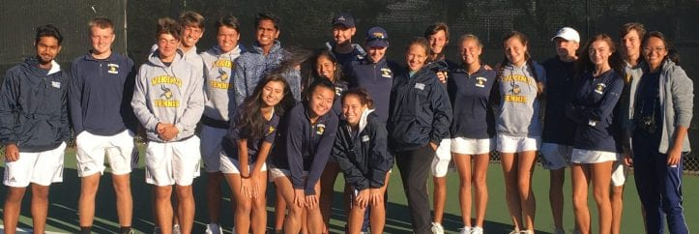
Choose your classes wisely
Spring registration determines the number of sections (classes) needed for each course.
Changes to course selections will not be granted after the scheduling deadline. Schedule changes will only be made for the following reasons:
  Failure of a required course
  Summer School course completion
  Class balancing
  Schedule errors
  Athletics or extra-curricular activities
The deadline to make changes for the 2024-2025 school year is
May 24, 2024!

Slide 16
For more information, you may…
  * See your counselor (see next page for emails)
  * Consult the AISD Course Description Handbook - a digital copy is available at www.aisd.net (search for “course description handbook”)
  * Visit the Career and Technical Education webpage at http://aisd.net/cte
  * Follow CTE on Twitter:
    https://twitter.com/CTEArlingtonISD

Slide 17
For more information:
  Counselors:
  A-Gr: Ms. Duncan, rduncan1@aisd.net
  Gu-Or: Ms. Simmons, gsimmon1@aisd.net
  Os-Z: Ms. Savoy, csavoy@aisd.net
  PTECH Students: Ms. Hudson, ahudson@aisd.net

Slide 18
For more information:
  JV Coaches (boys’ sports):
  Football, Coach Wiggins, hwiggins@aisd.net
  Basketball, Coach Wilson, kwilson7@aisd.net
  Cross Country, Coach Camp, rcamp2@aisd.net
  Track, Coach Najarro, znajarro@aisd.net
  Baseball, Coach Goodman, bgoodma2@aisd.net
  Soccer, Coach Soeun, ssoeun@aisd.net
  Tennis, Coach Monroe, jmonroe@aisd.net
  Golf, Coach Webb, gwebb@aisd.net
  Wrestling, Coach Myers, rmyers3@aisd.net
  Swimming, Coach Welch, rwelch@aisd.net

Slide 19
For more information:
  JV Coaches (girls’ sports):
  Volleyball, Coach Woodman, hwoodman@aisd.net
  Basketball, Coach Roberts, robert2@aisd.net
  Cross Country/Track, Coach Camp, rcamp2@aisd.net
  Softball, Coach Evans, devans2@aisd.net
  Soccer, Coach Hammonds, jhammon7@aisd.net
  Tennis, Coach Monroe, jmonroe@aisd.net
  Golf, Coach Holland, jhollan1@aisd.net
  Wrestling, Coach Stephens, gstephen@aisd.net
  Swimming, Coach Welch, rwelch@aisd.net

