Slide 1

freshman registration
2024
Lamar High School

Slide 2
Registration for 2024-2025
Students will be given registration materials in their class.
They will work with their teacher on their course selections and may reach out to their LHS counselor with any questions they may have.

Slide 3
To go to high school you must:
Pass 8th grade Math
Pass 8th grade English
Pass 8th grade Social Studies
Pass 8th grade Science
Have an overall average of 70% in all other classes

Slide 4

STAAR Tests for 8th Grade:
Reading
Math
Science
Social Studies

Slide 5


COURSE
DESCRIPTION
HANDBOOK
Found at
Aisd.net (students tab)

Slide 6

Use this book for:
- Course planning
- Course selection
- Information on:
GPA
UIL eligibility
Attendance rules
College/Tech school information
Graduation Information

Slide 7
Course descriptions show:
-AISD course number
-AISD course title
-Description of course
-Grade level offered*
-Prerequisites
-Credit received for course
*May be adjusted due to campus circumstances.

Slide 8
Example:
MA1245 - GEOMETRY
Relations, properties and measurement of surfaces, lines and angles in one, two, and three-dimensional figures are investigated and used in this course. It is designed to develop deductive thinking, and to emphasize problem solving using proofs and definitions while integrating algebraic concepts.
Grade Placement: 10-12
Prerequisite: Algebra I 1 unit

Slide 9

Grade classification
Freshman 0
Sophomore 6
Junior 12
Senior 18

Slide 10
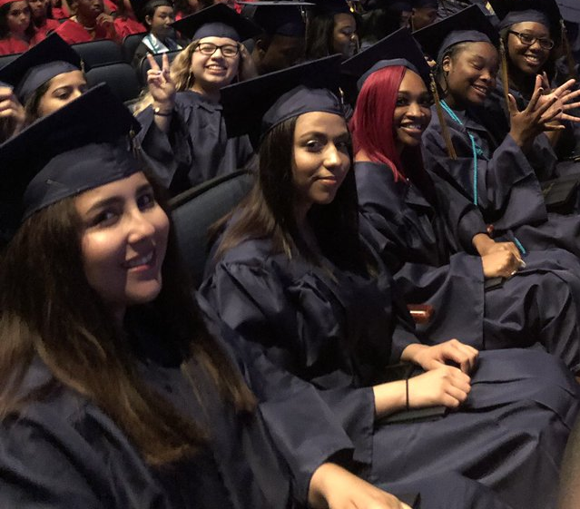
Graduation requirements
Foundation High School Program
Distinguished Level of Achievement (26 credits)
*4 credits of English
*4 credits of Math (to include Algebra I, Geometry, and Algebra II)
*4 credits of Science (to include Biology and at least one of these: IPC, Chemistry, or Physics)
*3 credits of Social Studies (to include US History and Government and Economics and at least one of these: W. History, W. Geography, or
AP Human Geography)
*2 credits of the same Foreign Language
*1 credit of PE
*1 credit of Fine Arts
*7 credits of Electives
***at least 1 endorsement (received by taking a series
4 credits in the same career pathway)

Slide 11
endorsements
There are five endorsement pathways:
STEM (Science, Technology, Engineering, Math)
Business and Industry
Public Services
Arts and Humanities
Multidisciplinary Studies

Slide 12

Staar eoc exams
In order to graduate, students must pass five STAAR EOC Exams with a level II or higher:
English I (9th grade year)
Algebra I (8th or 9th grade year)
Biology (8th or 9th grade year)
English II (10th grade year)
US History (11th grade year)

Slide 13

Performance acknowledgement
For outstanding performance:
  in dual credit – earning credit for 12 hours (4 courses) of dual credit
  In bilingualism and biliteracy
  on an AP test or IB exam
  on the PSAT, ACT-Plan, SAT, or ACT
  in earning a nationally or internationally recognized business or industry certification or license.

Slide 14
Enrolling in specialty courses
What you need to know

Slide 15

How can I join AVID?
Advancement Via Individual Determination (AVID)
Must complete an application √
Must be interviewed √
Must have a 2.0-3.5 GPA √
Must want to go to college √
Must be in Advanced Classes √
Must have determination to be successful √

Slide 16

IB (International Baccalaureate) Classes
  IB has a comprehensive two-year curriculum based upon international standards in six subject areas that begins junior year.
  These classes are challenging and involve projects and community service.
  Students may earn college credits through successful completion of the IB program.

Slide 17

Potential to earn college credit from UT-Austin
Currently these classes are at LHS: College Algebra, Statistics, Precalculus, Geoscience (Earth, Wind, and Fire), and Physics
College Algebra can count as the Algebra II requirement (must pass Algebra I and Geometry before enrolling in the class).
These classes receive weighted credit.

Slide 18

Why take advanced classes?
*They can help you prepare better for the rigors of college work.
*They can help your rank and gpa (grade point average) because you do receive extra rank and gpa points in these classes since you complete more challenging work.
*Not sure if advanced classes are right for you? Advanced World Geography is a great one to try. If you sign up for it, you’ll need to stay in for the first six-weeks but will be allowed to exit (if you have parent permission) after the first six-weeks ends.
https://www.youtube.com/watch?v=sqEAQJgvk5o
Click the link above to watch the video and then click to the next slide when finished.

Slide 19
Spanish: Native Speakers
Advanced (formerly Pre-AP) Spanish III
*Students may start at this level if they read, write, and speak Spanish well.
Spanish II
*For students who speak Spanish at home but do not read or write it well, they may begin at the second level of Spanish.

Slide 20

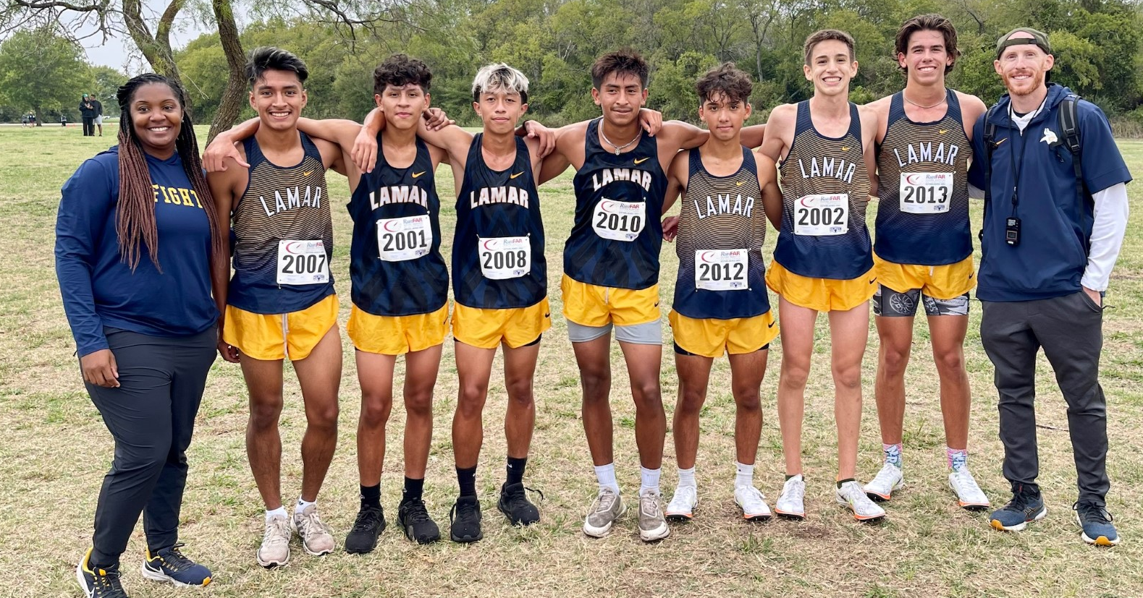
Specialty Courses – Extracurricular Classes
Some classes require try-outs or permission from the coach or teacher. Examples of these classes include athletics, cheerleading, drill team, newspaper, and yearbook.

Slide 21

Athletics
Students may sign up for any sport but try-outs are the first week in August – if they don’t make the team, they will not be in the class.
Students must have a physical turned in before school starts and all AISD athletic forms must be completed.
To maintain eligibility to play, students must pass their classes for each grading period.
Most sports are double-blocked throughout the year.
Viking Pride Strength and Conditioning Camp starts in June – 6-week free day camp (M-TH)
…more info to come
on www.aisd.net/lamar
http://w2.aisd.net/aisd/athletics
for forms and more
Contact Athletic Coordinators
Billy Skinner or Heather Woodman
for questions
regarding athletics at:
bskinner@aisd.net
or
hwoodman@aisd.net.

Slide 22
Fine arts
Students may sign up for Choir, Dance, Theatre Arts, Band, Orchestra, and Art I.
The director of each musical program will determine which sections of the course the student will take.
To maintain eligibility to perform in competitions or recitals, students must pass their classes for each grading period.
Band and Orchestra are usually double-blocked.
Color Guard is a class associated with the band program and earns PE and Fine Arts Credit.

Slide 23
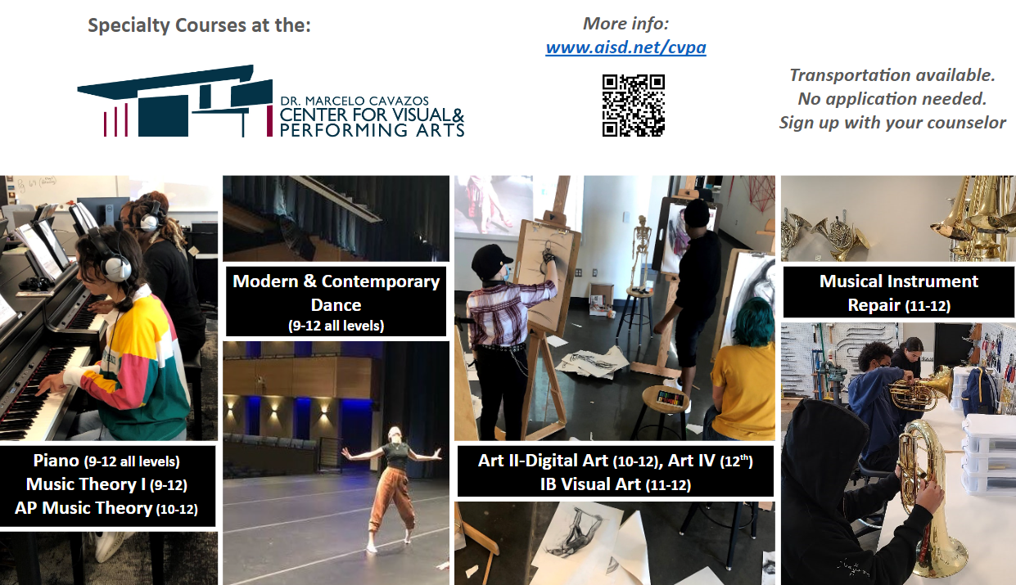

Slide 24
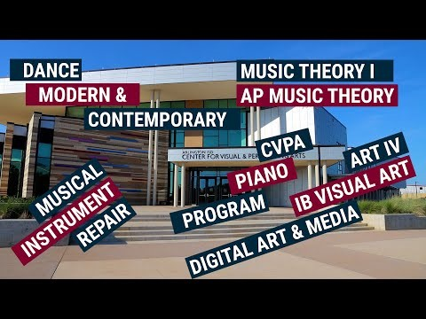
Click the play icon once it loads. when it finishes, the slide will advance on its own.

Slide 25
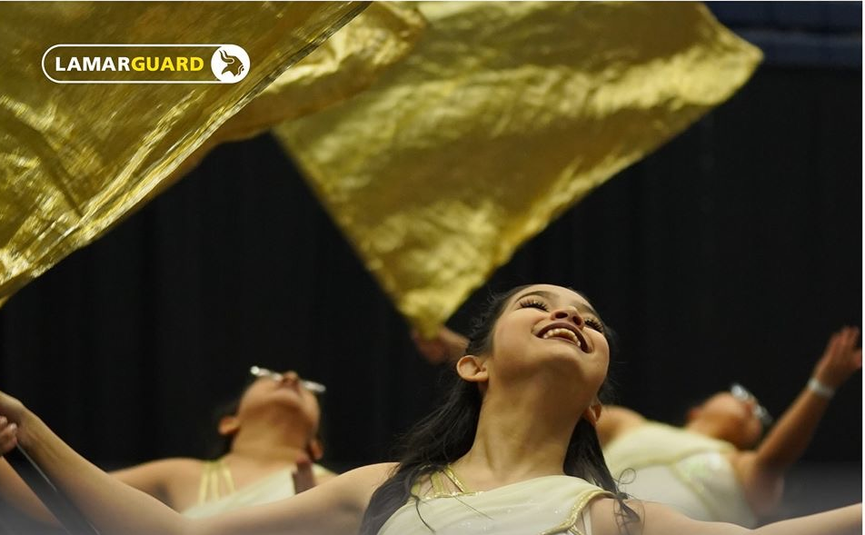

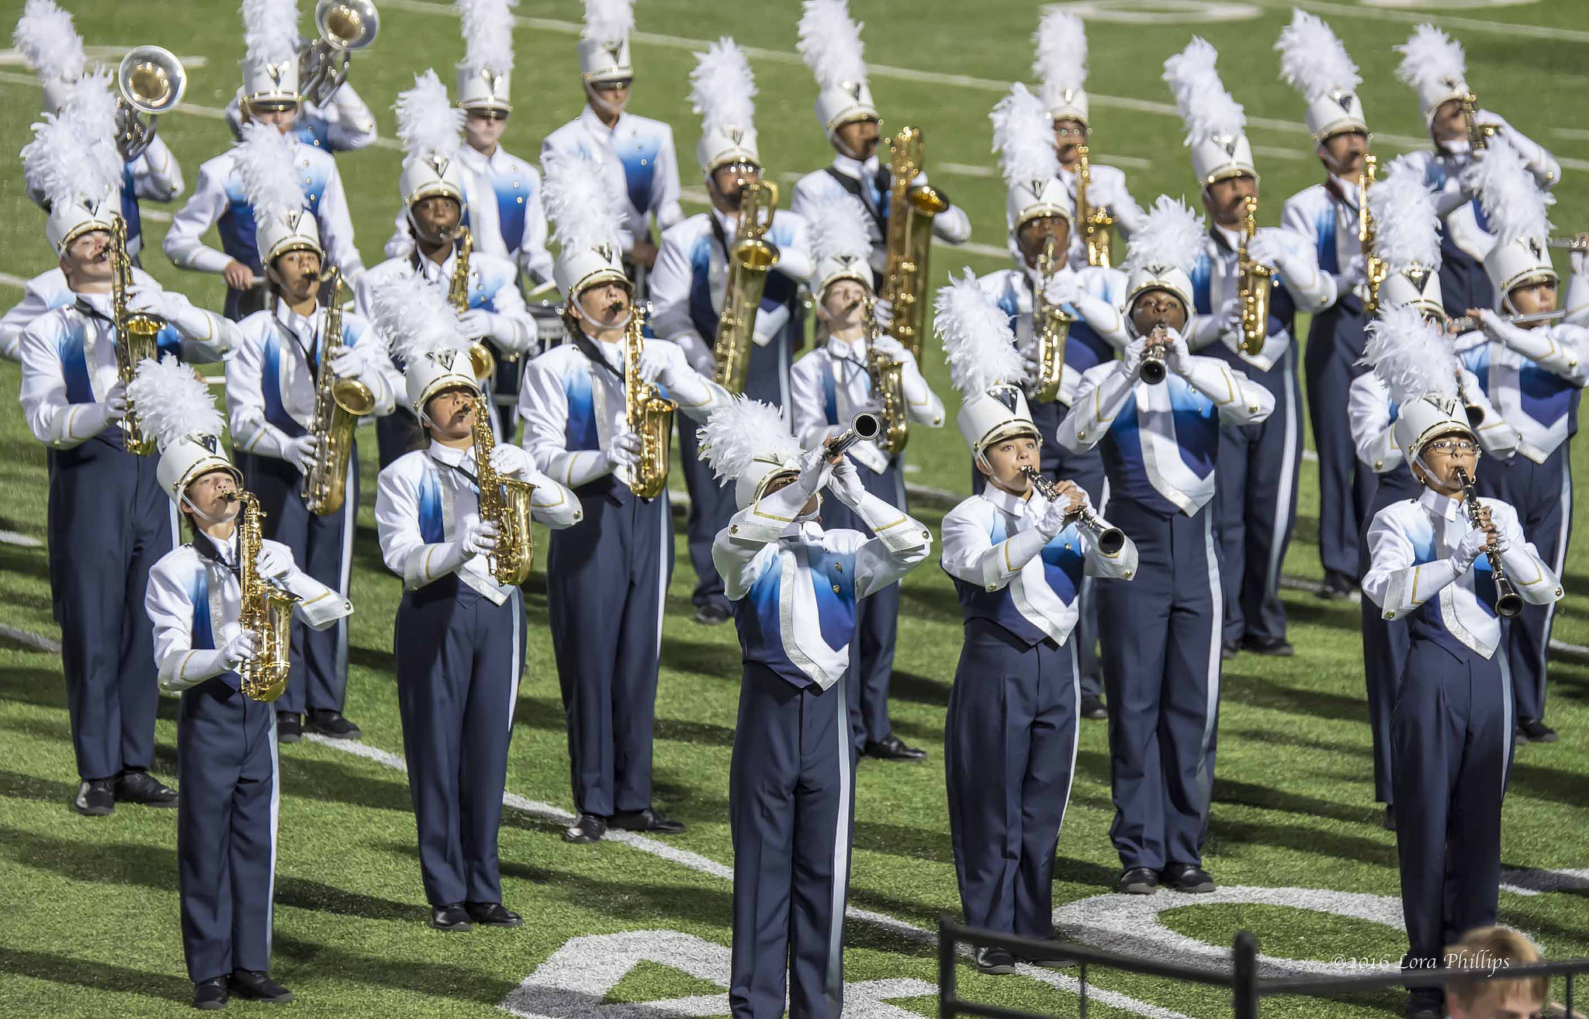



Band
The Lamar Band program has a variety of opportunities for all students who have been in band in JH.
Students enroll in band for the full year and band is normally double blocked.
Band students will earn Fine Arts, PE, and elective credits.
10-12 grade band members can take Honors Music for a GPA boost with weighted credit.
The different elements of the band program are:
  Marching Band
  Concert Band
  Jazz Band
  Symphony Orchestra
  Color Guard / Winter Guard
See a director for questions
  Alan Lang dlang@aisd.net
…more info www.lamarmusic.org

Slide 26
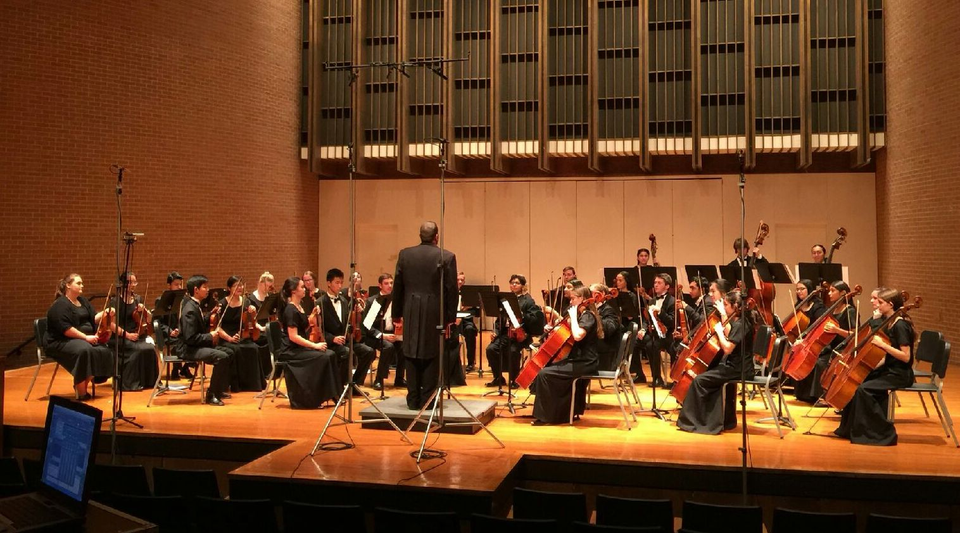

orchestra
The Lamar Orchestra program has many opportunities for all students who have been in orchestra in JH. Additionally, any student who has previously been in orchestra for at least one year of study can choose to re-enroll in the program.
Students enroll in orchestra for the full year and double blocking is highly encouraged.
Orchestra students will earn Fine Arts and elective credits.
10-12 grade orchestra members can take Honors Music for a GPA boost with weighted credit.
Opportunities to perform in the orchestra program include:
  Concerts
  Community Performances & Elementary Tours
  Pit Orchestra for Musical Productions
  Spring Trips
See a director for questions
  Andrew Walton fwalton@aisd.net
…more info www.lamarorchestra.com
Caption
Caption

Slide 27
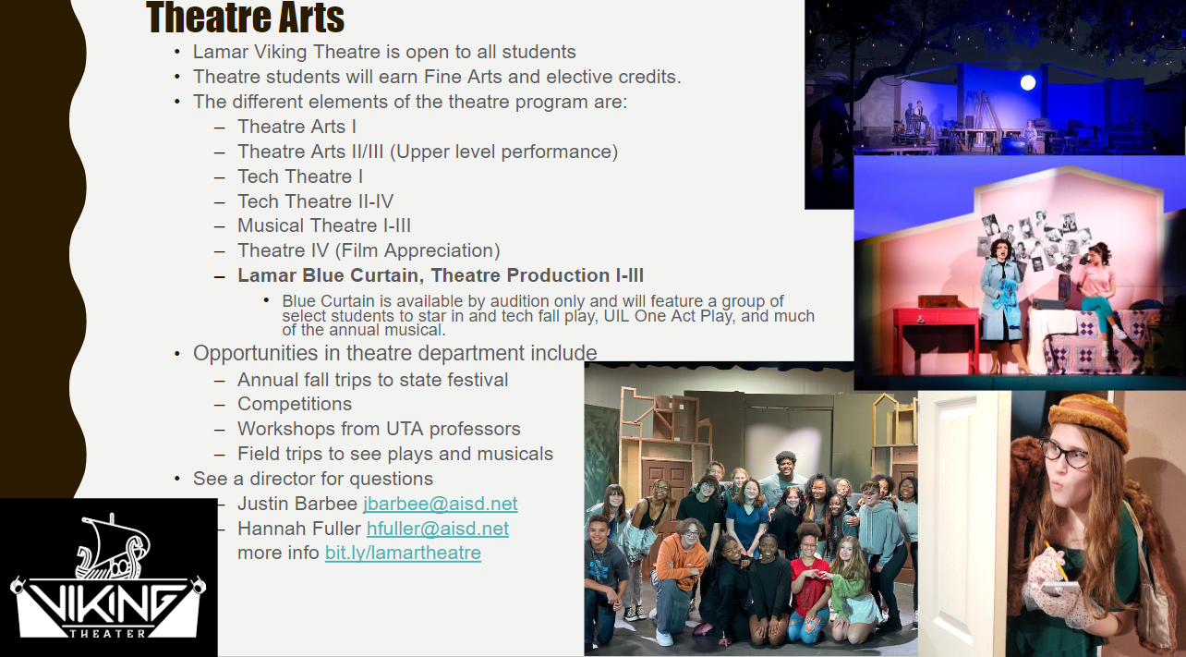

Slide 28

Viqueens
Clinic ~ March 4-7, 2024 at LHS main gym 4:30-6pm
Friday, March 8 tryouts at
LHS main gym 4-7pm
www.lamarviqueens.weebly.com
for more info

Slide 29
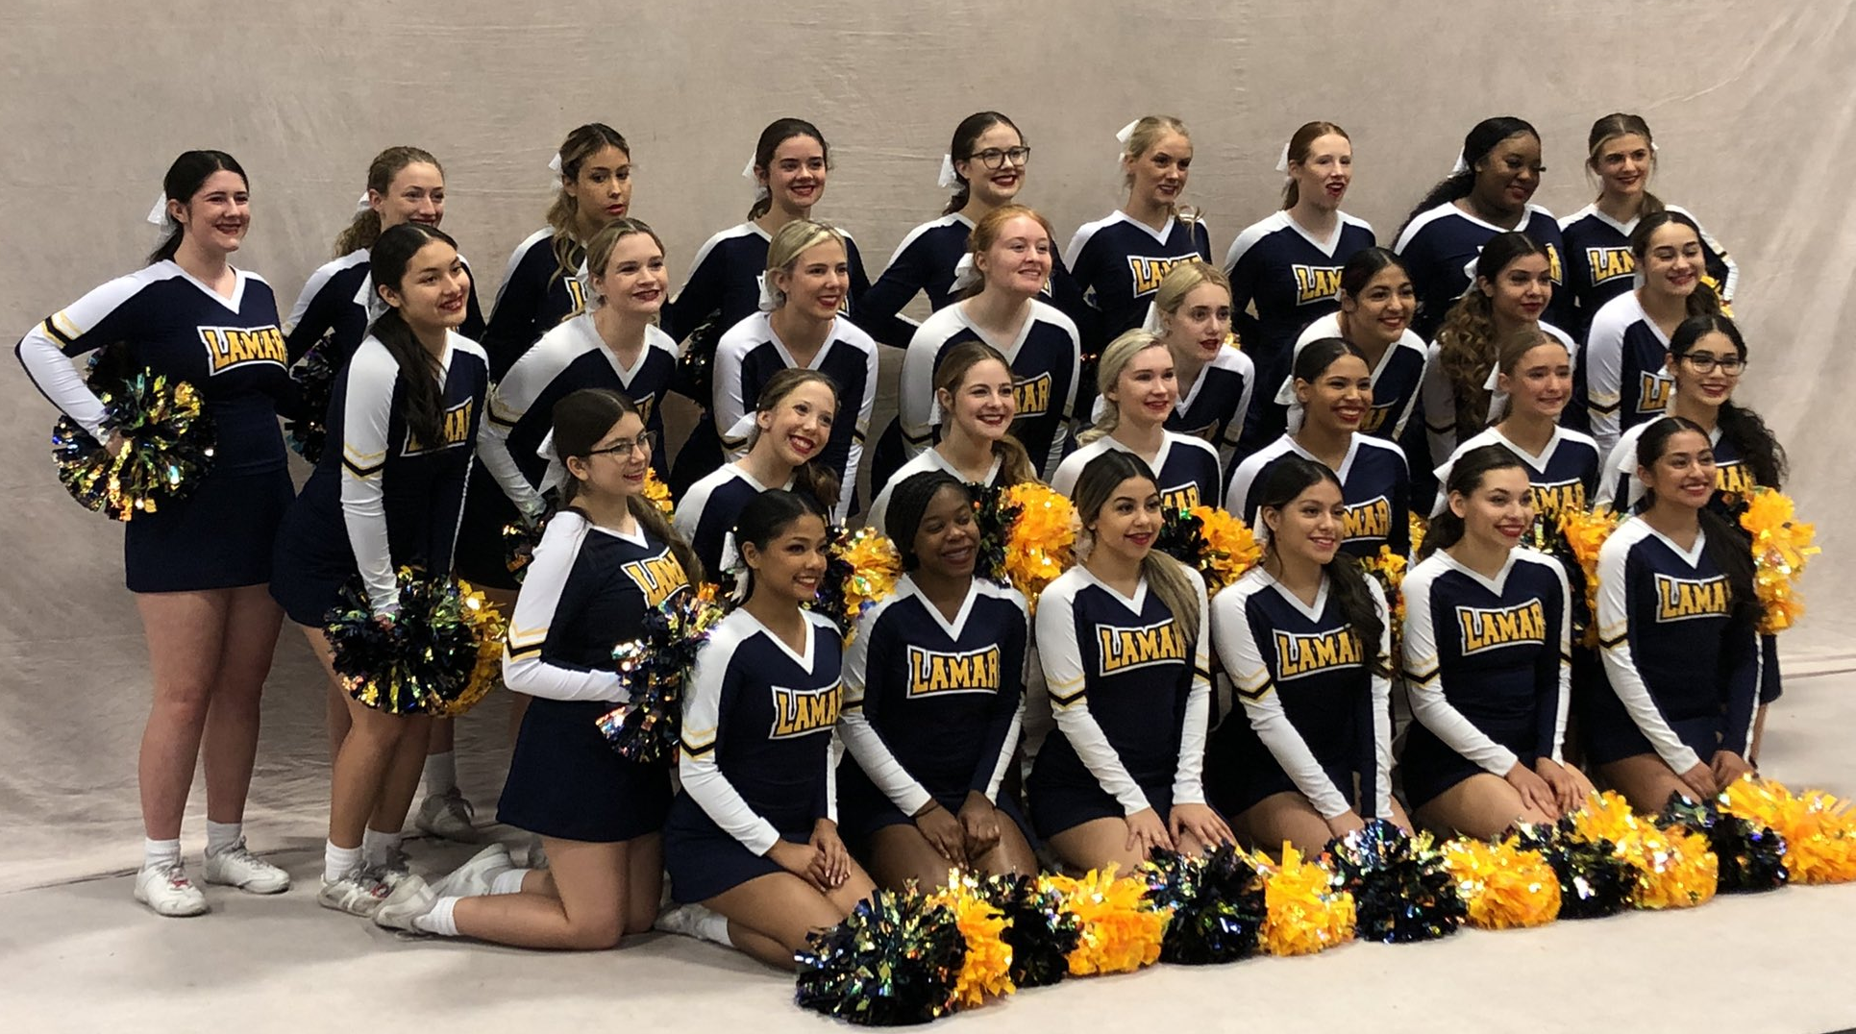
CHEERLEADING
Mandatory Cheer Candidate and Parent Meeting: TBD
For questions, please contact Coach Hall at jhall8@aisd.net

Slide 30
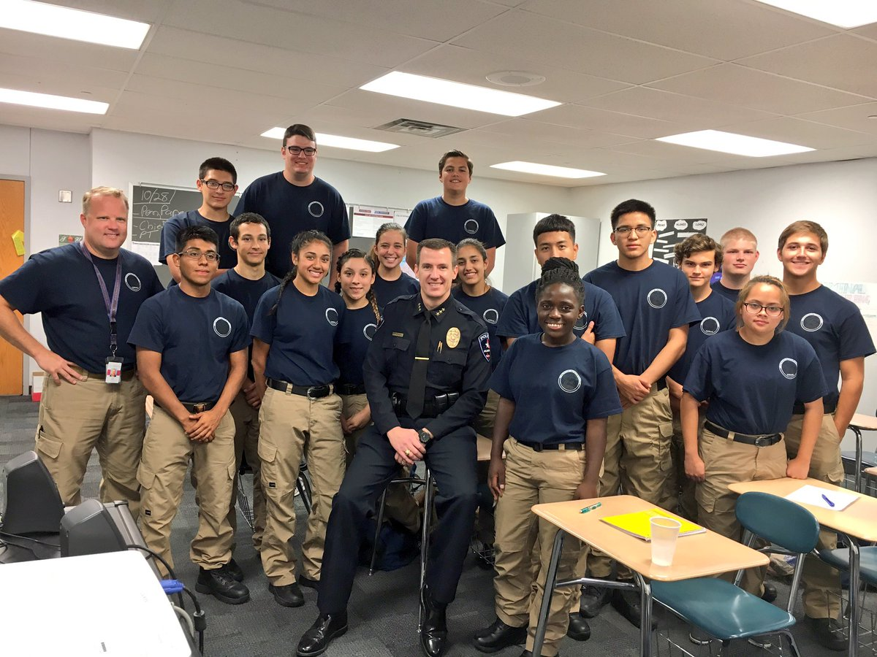
Specialty courses (junior and senior years)
Some classes and programs require an application.
These programs are:
  Workforce and Academic Dual Credit courses
    Classes taught by TCC professors in
    which students earn college credit
  Fire Academy
  AISD Police Academy
  Cosmetology
  Culinary Arts
  Hospitality
  Construction Technology, Architecture
  Computer Technician
  Agriculture, Floral Design/Plant Science, Vet Assistant
  Instructional Practices (Teaching!)
  Health Science, Biomedical Science
  Law, Public Safety, Corrections, & Security
  Practicums in STEM – Engineering, Computer Science
  Practicum in Human Services
  Business & Finance; Marketing; Entrepreneurship; Manufacturing; Transportation
  Art & A/V Technology, and Communications; Video Game Design; Photography

Slide 31
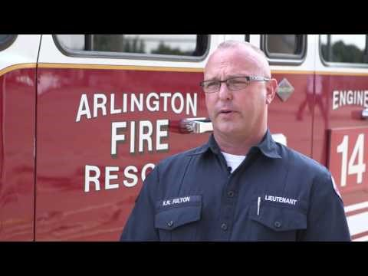
Career and technical center
Click the play icon once it loads.
When it finishes, the slide will advance on its own.
https://www.youtube.com/watch?v=gzx7iY_iaWc&t=39s

Slide 32
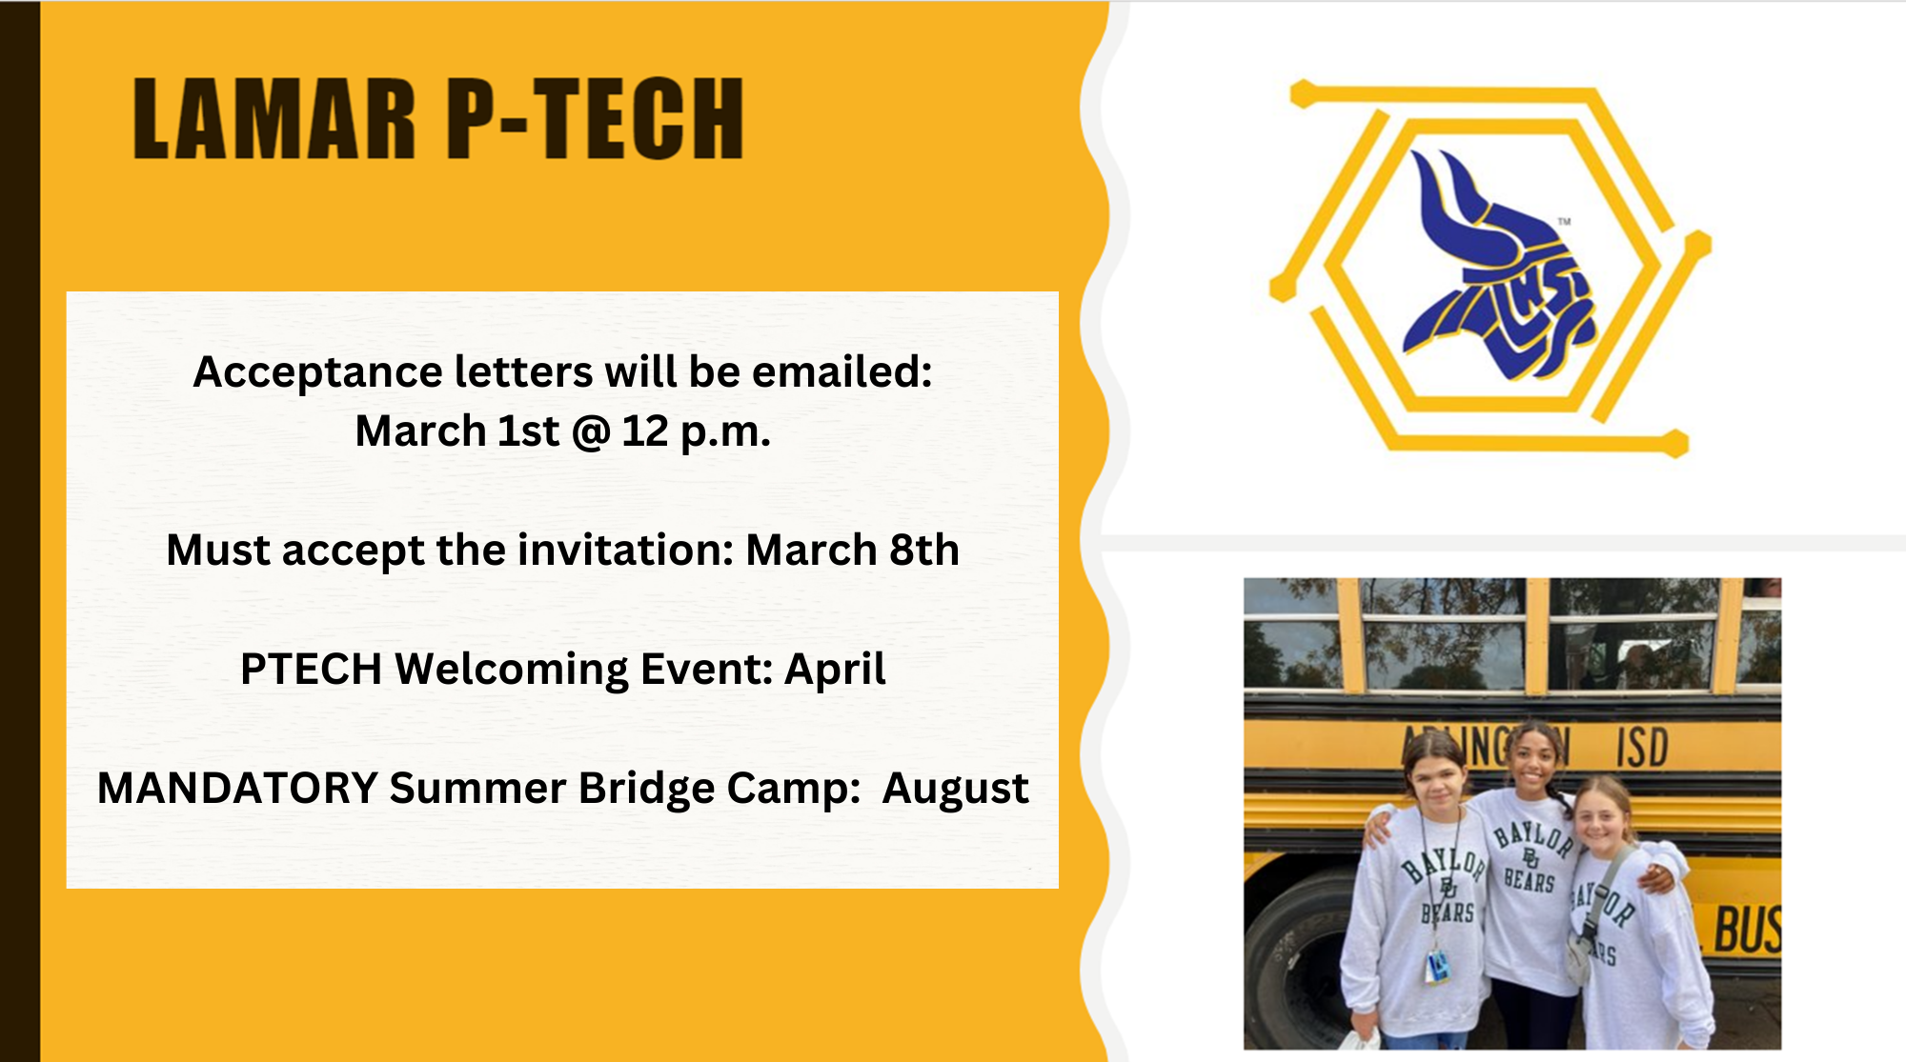

Slide 33
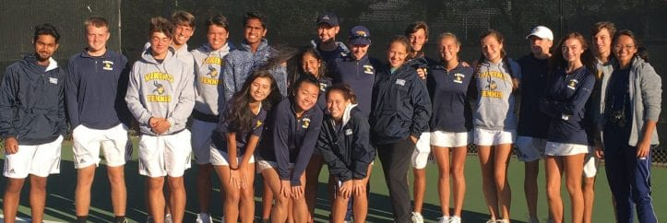
Choose classes wisely
Spring registration determines the number of sections (classes) needed for each course.
Changes to course selections will not be granted after the scheduling deadline. Schedule changes will only be made in August for the following reasons:
  Failure of a required course
  Summer School course completion
  Class balancing
  Scheduling errors
  Athletics or extra-curricular activities
Deadline to change course choices with the LHS counselor:
May 24th, 2024

Slide 34
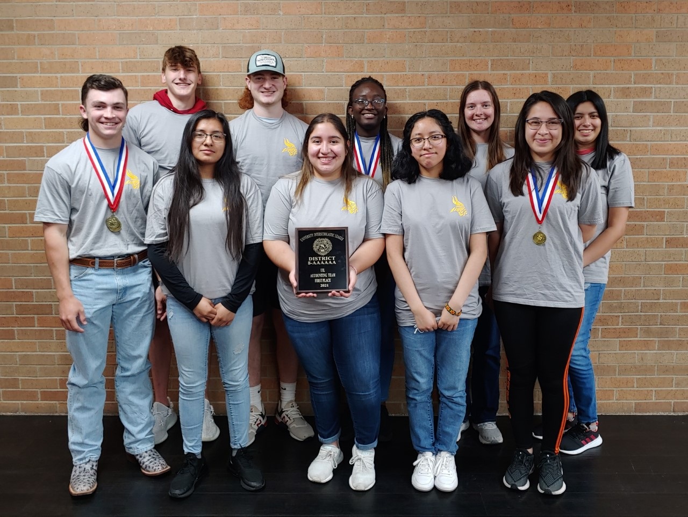
LAMAR COUNSELORS
Mrs. Duncan A-Gr
Ms. Simmons Gu-Or
Mrs. Savoy Os-Z
Ms. Hudson P-Tech (not alpha)
LHS Web Site: WWW.AISD.NET/LAMAR
  Lamar Counseling Office Number: 682-867-8310
LHS Award Winning UIL Accounting Team

