Slide 1
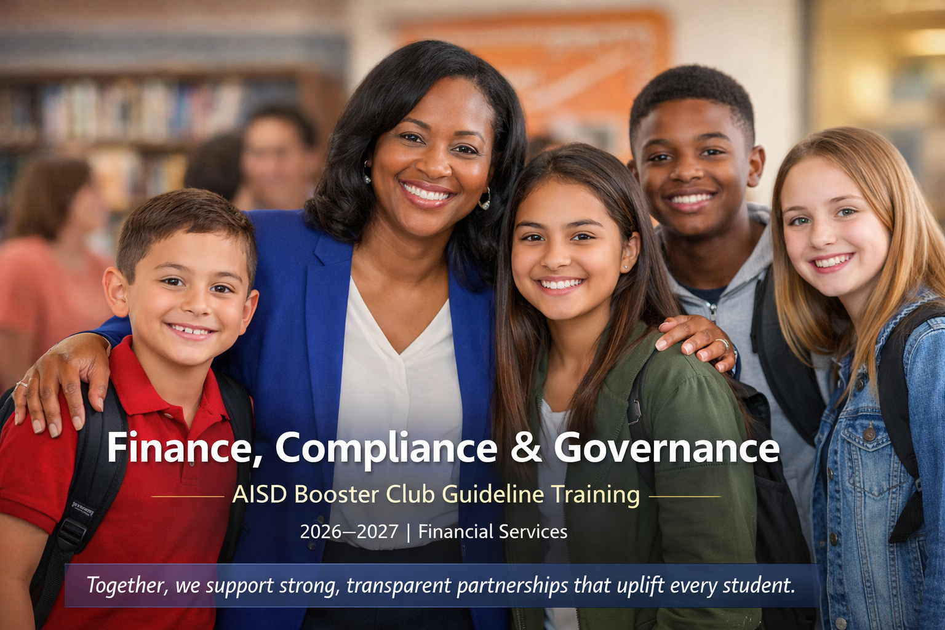

Slide 2
Training
Agenda
1
Purpose
6
Risk
Management
2
District
A quick roadmap through UIL, District, and IRS booster club expectations, controls, and accountability.
Booster
Club
Training
5
IRS
3
Risk
Management
4
UIL

Slide 3
Understanding School-Support Organizations
Booster Clubs support a specific student program or activity; expands educational opportunities beyond district-funded resources.
Manual Applies to Booster Clubs
The Booster Club manual is intended for Booster Clubs.
District Affiliated School-Support Organizations
Support schools and student programs while operating in alignment with district policies.
Follow Applicable District Policies
All support groups should operate in accordance with applicable district requirements.
Fundraising Alone Does Not Create a Booster Club
Groups may fundraise without becoming a Booster Club.
Parent & Volunteer Groups
PTAs, PTOs, Dad’s Clubs, and similar organizations.

Slide 4

Arlington ISD
District Expectations for Booster Clubs

Slide 5
District Relationship Overview
Booster clubs are independent organizations, not campus clubs
Principals provide oversight, not financial management
Booster clubs must follow district policies, UIL rules, and their own bylaws
Collaboration is essential — but roles must remain separate and clear
Coaches and sponsors may collaborate and serve as the liaison between the booster club and principal.

Slide 6
Booster Club Responsibilities
Booster Clubs operate separately from Arlington ISD
Work with campus administration on activities, fundraising, purchases and donations
Keep the campus informed of Booster Club Activities
Booster Clubs remain responsible for their own organization and finances
Keep Booster Club funds separate from Arlington ISD Activity Funds.

Slide 7

Social Media & Public Messaging
Public posts should be professional, authorized, respectful, informative, and coordinated.
Be Professional
Posts must reflect positive communication.
Be Authorized
Do not use district logos without permission.
Be Respectful
Avoid posting student information without consent.
Social media is public communication. Treat it like official messaging.
Be Coordinated
Coordinate messaging with campus administration.

Slide 8
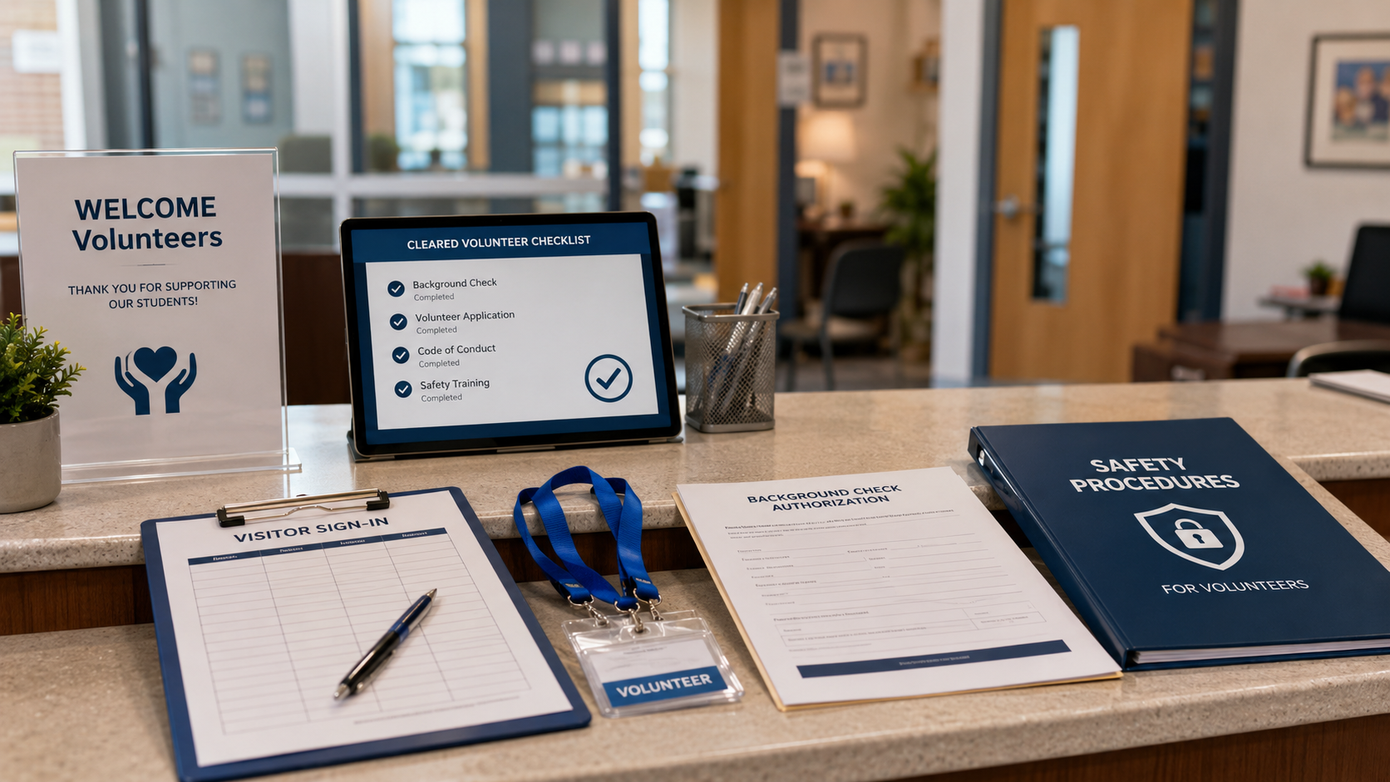
Volunteer Requirements
Clearance-to-Service Flow
1
Be Approved
Complete the district background check.
2
Be Safe
Follow campus safety procedures.
3
Be Accountable
Only approved volunteers may handle cash.
Volunteers support students best when expectations are clear before they serve.
4
Be Present
Sign in through the front office.
5
Be Verified
Maintain a list of cleared volunteers.
Protect students, volunteers, and the District by verifying clearance before service begins.

Slide 9
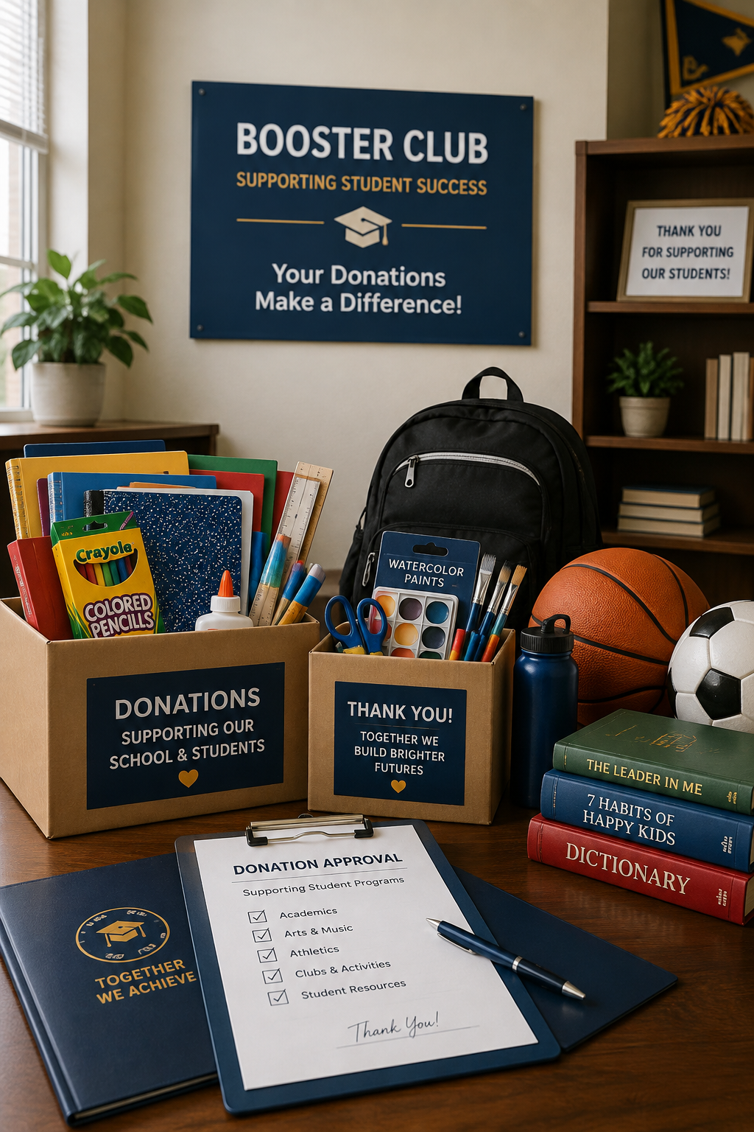
Gifts & Donations
Donations must support the student program and follow the District acceptance process.
Approve: All gifts must be approved by the District.
1
Equipment, supplies, services, or funds (preferred) may be donated. Donation forms will be completed by the campus and submitted to the Purchasing Department.
2
3
Accept: District formally accepts gifts before they become District property.
No cash prizes, cash incentives, or gift cards
4
Donations over $250 complete the donation form.
5

Slide 10
Purchasing & Expenditures
Discuss major purchases with campus administration before committing Booster Club funds.
Confirm that the purchase supports the student program or activity.
Obtain appropriate approval before making large purchases
When unsure whether a purchase is appropriate, check before proceeding.

Slide 11
Booster Club Annual Checklist
Use the annual checklist to stay compliant and in good standing.
1
2
4
5
6
Be strategically aligned
Approve annual budget to guide financial decisions.
Be Current
Update bylaws, officers, and records annually.
Be Tax Compliant
File IRS Form 990 annually.
Be Trained and Ready
Train incoming officers and transfer records.
Be in Good Standing
Maintain compliance with District requirements.
Complete these items every year to support accountability, continuity, and compliance.

Slide 12

Be
Be Accountable
make timely deposits and maintain clear documentation
Be
Be Thorough
Store fundraiser forms and profit/loss reports
Be
Be Prepared
Retain annual audits and year‑end summaries
Be
Be Compliant
Records should be kept for at least 7 years
Be
Be Proactive
secure cash and limit access during events.
Fundraiser/profit loss form is available for use.

Slide 13
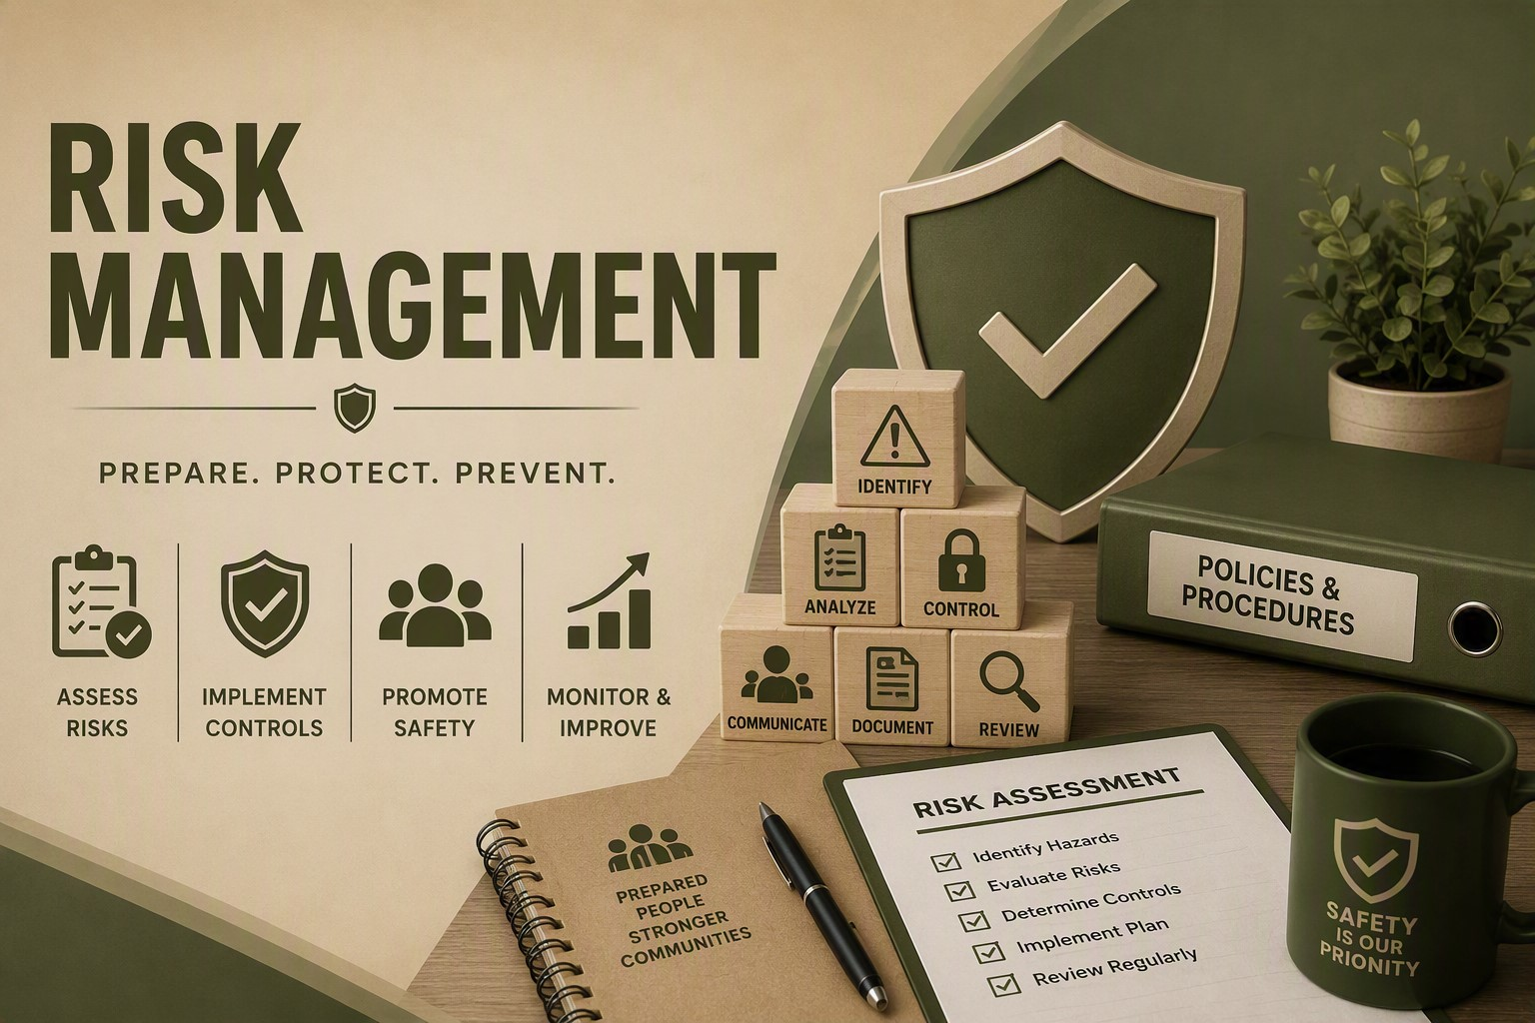

Slide 14
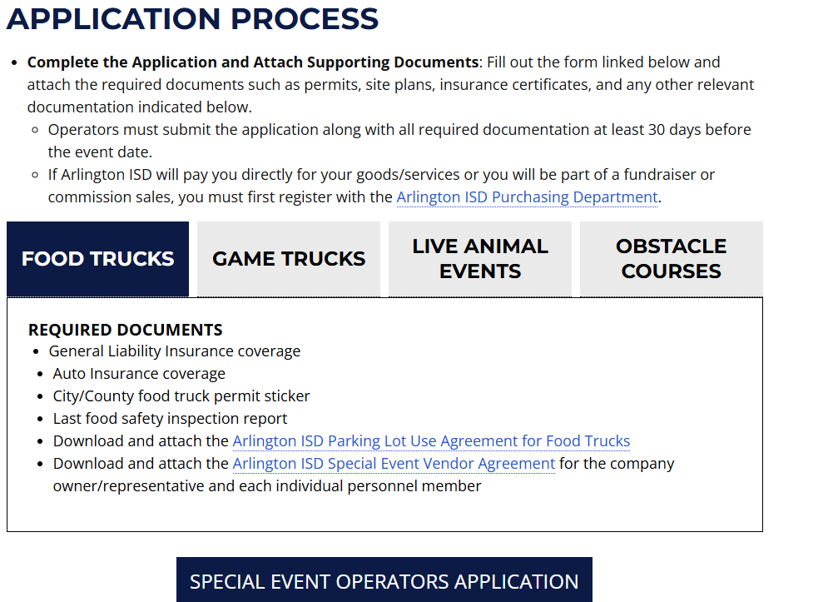

Slide 15
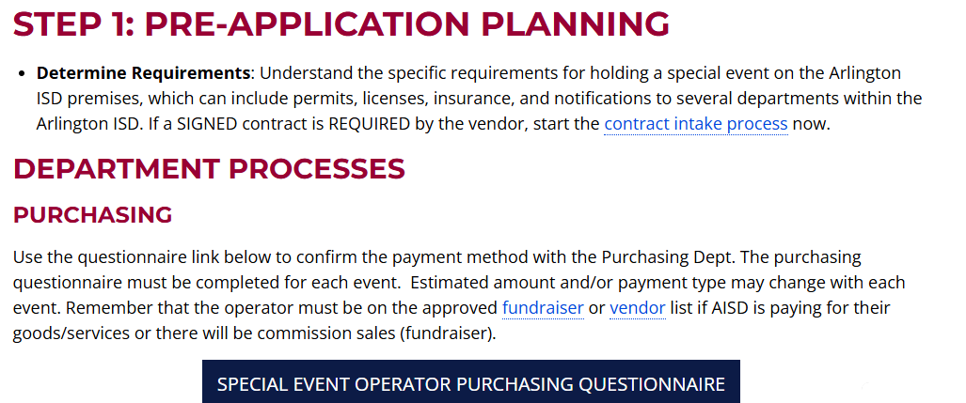

Intranet for campus personnel access

Slide 16
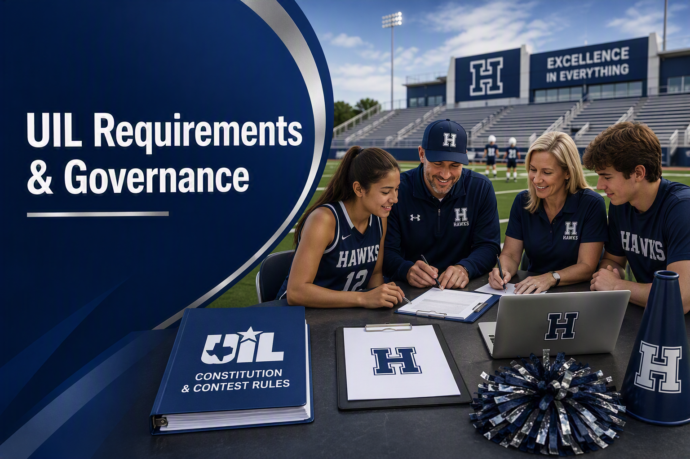
Supporting UIL Activities & Students

Slide 17
Financial Controls and Accountability
Maintain
Keep
Require
Require appropriate documentation for expenditures and reimbursements.
Use
Use Booster Club funds to support the student program – not individuals.
Maintain
Maintain bank statements, receipts financial reports, and other supporting documentation.
Follow
Follow the Booster Club’s bylaws and established financial procedures.
Periodic financial statements itemizing all receipts, expenditures and meeting minutes should be made available to the general club membership and kept on file at the school.
transparent, accurate financial records.
Require
No cash prizes, cash incentives, or gift cards be given to students.
Use
Fair and transparent practices when selecting vendors.

Slide 18
UIL: Students, Coaches & Benefits
Before giving anything to a student, coach, or sponsor — CHECK FIRST.
Student awards and benefits may be subject to UIL rules.
Athletic students are subject to the Athletic Amateur Rule.
Athletic Booster Club funds may not be used for athletic camps, clinics, private instruction, or non-school activities.
Coaches/directors should not control or have signature authority over Booster Club funds.
Coaches/directors may not accept more than $500 in money, products, or services for recognition or appreciation during a calendar year.
Coaches may not receive funds gathered by a high school Booster Club.

Slide 19
Booster Club Meetings
Meetings create the official record of decisions and help protect accountability.
1
2
3
4
Follow Bylaws
Meetings must follow the approved bylaws.
Share Agenda
Agendas should be shared in advance.
Record Minutes
Minutes must be recorded and retained.
Vote Properly
Votes must follow quorum and voting rules.
A strong meeting process makes decisions clear, documented, and defensible.
Good minutes should show what was discussed, what was approved, who voted, and what actions are required next.

Slide 20

Conflict of Interest
Decisions must be transparent, fair, and focused on the student program.
Personal Benefit
Booster officers must avoid personal financial benefit.
Staff Direction
Campus staff cannot direct Booster Club spending.
1
2
Vendor Selection
Use fair, transparent vendor practices.
Avoid even the appearance of conflict
3
5
When in doubt, pause and ask before proceeding.

Slide 21
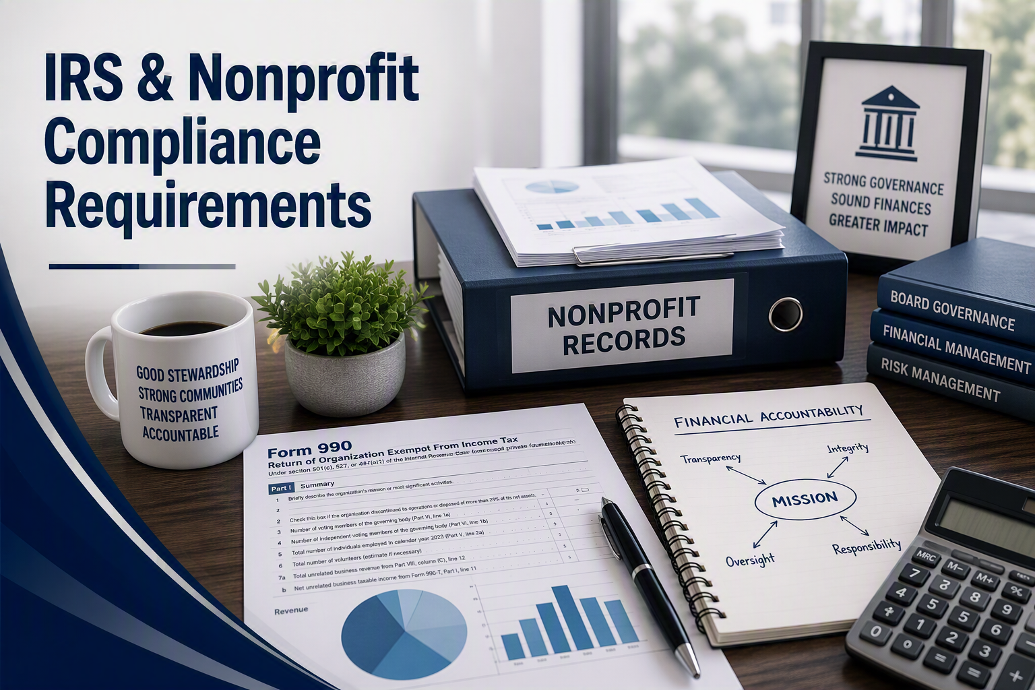
Federal Tax and
Filing Responsibilities

Slide 22
Recordkeeping: What to Keep for 501(C)3 organizations
Meting agendas, minutes, and attendance/sign-in records.
Bank statements and financial reports.
Receipts, invoices, and other supporting documentation.
Fundraising records and required financial reports.
Donation and expenditure documentation.
Annual financial records and other required reports.
Keep records according to AISD and applicable legal requirements.
Good records protect the Booster Club and help ensure transparency.

Slide 23
IRS: Federal Tax Status
A Booster Club is not automatically a 501(c)(3) organization.
Know your organization's EIN and federal tax status.
If recognized as tax-exempt, the organization must continue to meet applicable IRS requirements.
Federal tax-exempt status and Texas tax exemptions are separate requirements.
Keep organizational and financial records that support the Booster Club's federal tax status.

Slide 24
IRS: Filing & Records
Most tax-exempt organizations have an annual IRS filing requirement.
The appropriate filing depends on the organization's circumstances.
Possible filings include Form 990, Form 990-EZ, or Form 990-N.
Know your organization's filing requirement and filing deadline.
Keep financial and tax records needed to support the organization's filings.
Failure to file a required return or notice for three consecutive years can result in automatic revocation of tax-exempt status.
Questions about federal tax requirements should be directed to the IRS or a qualified tax professional.

Slide 25
Resources
Reference these resources for nonprofit, tax, and UIL guidance.
1
Texas Secretary of State
2
Internal Revenue Service
Nonprofit Organizations
Tax Information
https://www.sos.state.tx.us/corp/nonprofit_org.shtml
irs.gov
(512) 463-5555
1-800-829-1040
3
IRS Exempt Organizations
4
Texas Comptroller
Charities & Nonprofits
Tax Information
irs.gov/charities-non-profits
comptroller.texas.gov
1-877-829-5500
1-800-252-5555
5
Texas Comptroller
6
University Interscholastic League
Exempt Organizations
comptroller.texas.gov/taxes/exempt
uiltexas.org
1-800-252-5555
(512) 471-5883
7
UIL Booster Club Guidelines
Booster Club Guidance
uiltexas.org/policy/guidelines-for-booster-clubs
(512) 471-5883
The following resources will help you and your club be successful.

Slide 26


Thank You for Your Leadership & Partnership

