Slide 1

FSA ID Guide

Slide 2
Creating an FSA ID
What is an FSA ID? The Federal Student Aid (FSA) ID is a username and password that is required to log in and access all Federal Student Aid websites, including the FAFSA. The FSA ID also serves as a legal signature when you submit your FAFSA.
Who should create an FSA ID? You and one or both of your parents must create an FSA ID before completing the FAFSA, even if your parent does not have a social security number. If you are an independent student, you will not need to have your parent or legal guardian create an FSA ID. If you have a sibling who attended college before you, your parent may already have an FSA ID. If you are a student without a social security number, you will not be able to create an FSA ID or complete the FAFSA. Visit the GO Center to learn more about the TASFA.

Slide 3
Creating an FSA ID
Go to studentaid.gov and click “create account” in the upper right-hand corner. The application is available in English and Spanish.
What information do I need to create an FSA ID?
  Full name and social security number, as they appear on social security card (if applicable)
  Date of birth
  Valid email address & phone number
  Immediate access to your email account
  Your residential address
Save your FSA ID username and password somewhere safe!

Slide 4
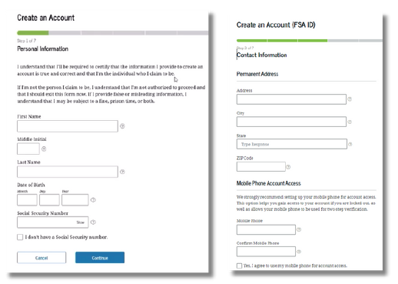
Creating an FSA ID
Add name, date of birth and social security exactly as it appears on official documentation.
Check the box if you don’t have a social security number and see the next page for more information
Create a password that you don’t use for other accounts
Provide your mobile phone number for more ways to access your account

Slide 5
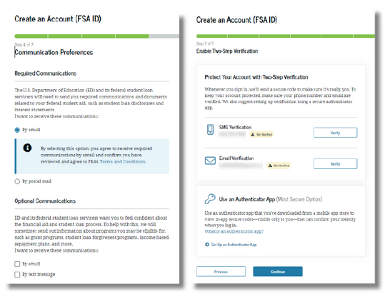
Creating an FSA ID
Select how you would like the Department of Education to communicate with you, and in what language
We recommend email to get communications quickly
Set up two-step verification for your FSA ID with your phone number, email and/or authenticator app
We recommend setting up all methods so you have multiple options to log in

Slide 6
Forgot your password or ID?
If you have an FSA ID but cannot remember your username or password, DO NOT try and create another FSA ID.
Your FSA ID is associated with your social security number, so you can only have one. Instead, just click “Forgot My Username” or “Forgot My Password” to retrieve your FSA ID information.

Slide 7
Need help?
StudentAid.gov – Use the chat function to speak with a professional about the FAFSA application process
Federal Student Aid Information Center Phone Number: 1-800-433-3243
CollegeForAllTexans.com
Visit your school’s GO Center!

