Slide 1

2025–26 TASFA

Slide 2

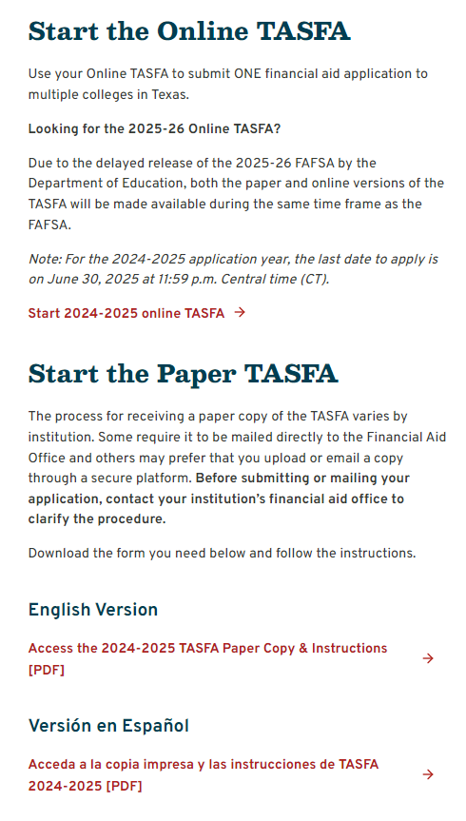

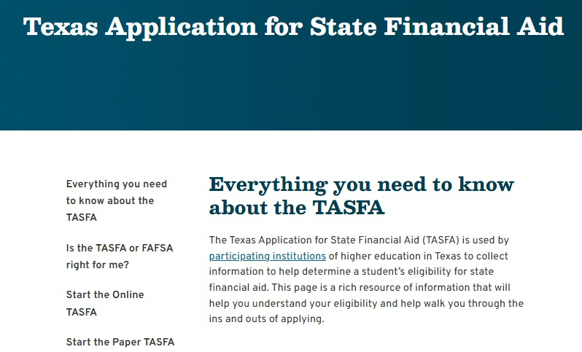
TASFA Landing Page

Slide 3


Rochelle is not sure if she should fill out the TASFA or the FAFSA, what should she do?

Slide 4

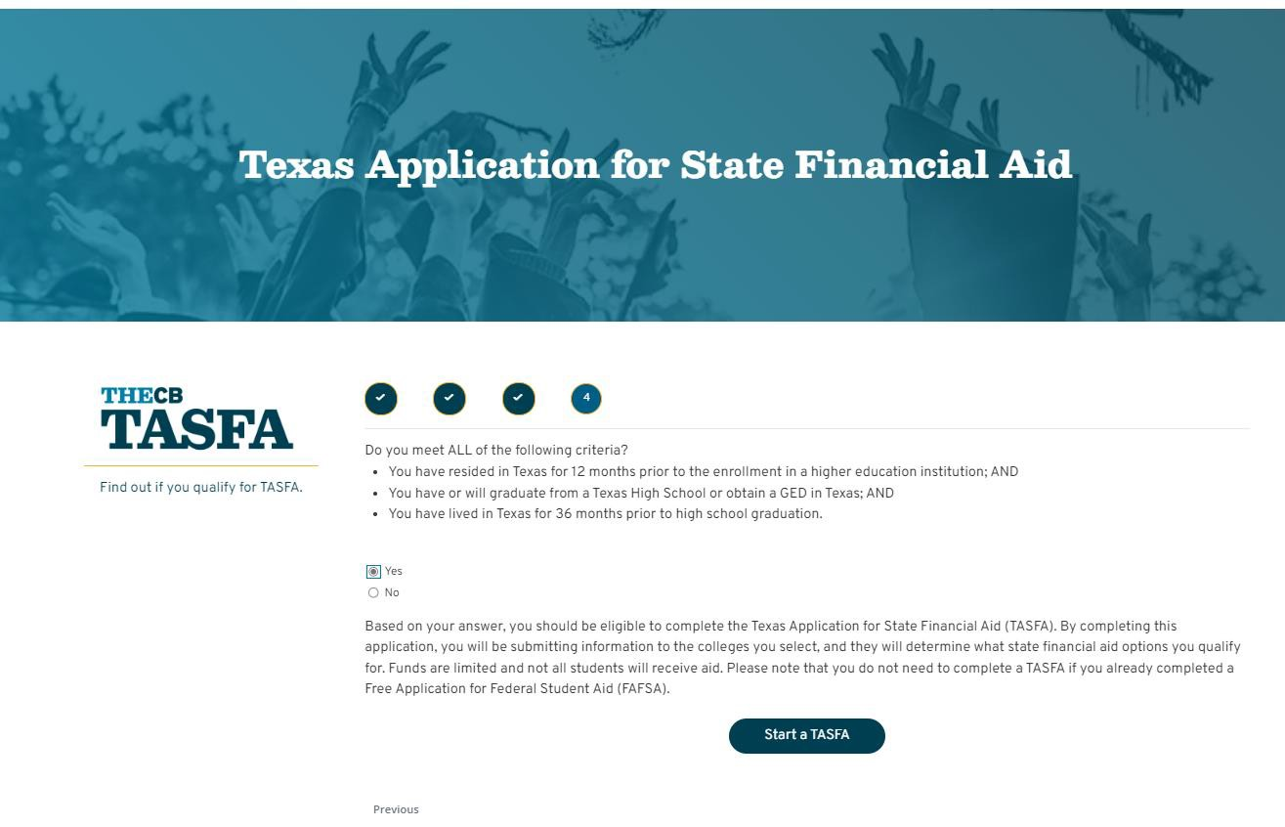
Decision Tree
25

Slide 5


The THECB does not determine what supporting documents are required from TASFA applicants. We recommend students contact their institution for additional information.
Counselor Tony wants to know, what specific
information will a student need to fill out the TASFA?

Slide 6

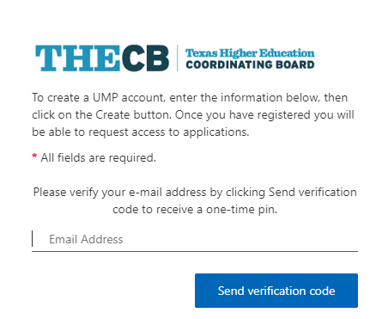
User Account Creation
New users will be required to create an account with a valid email.
A secure code will be sent to the user to first verify their email.
Note: Students are the only users that create a TASFA account.

Slide 7

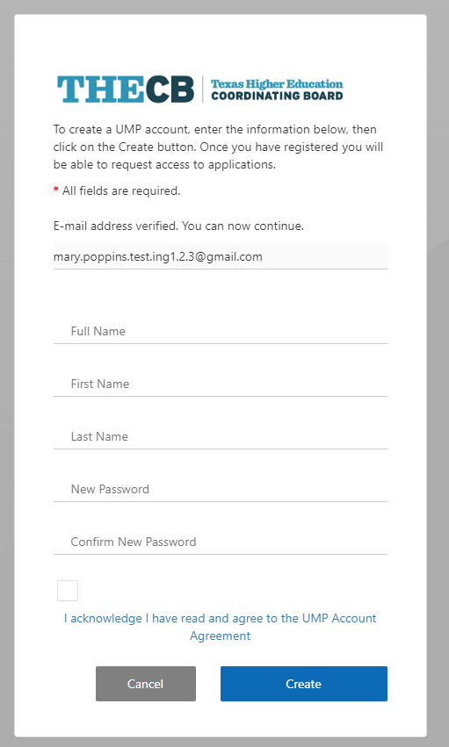
TASFA Account Registration
The user creates their account by completing a short registration form.
After the account is created, they must log in and verify using a code that is provided via email.

Slide 8

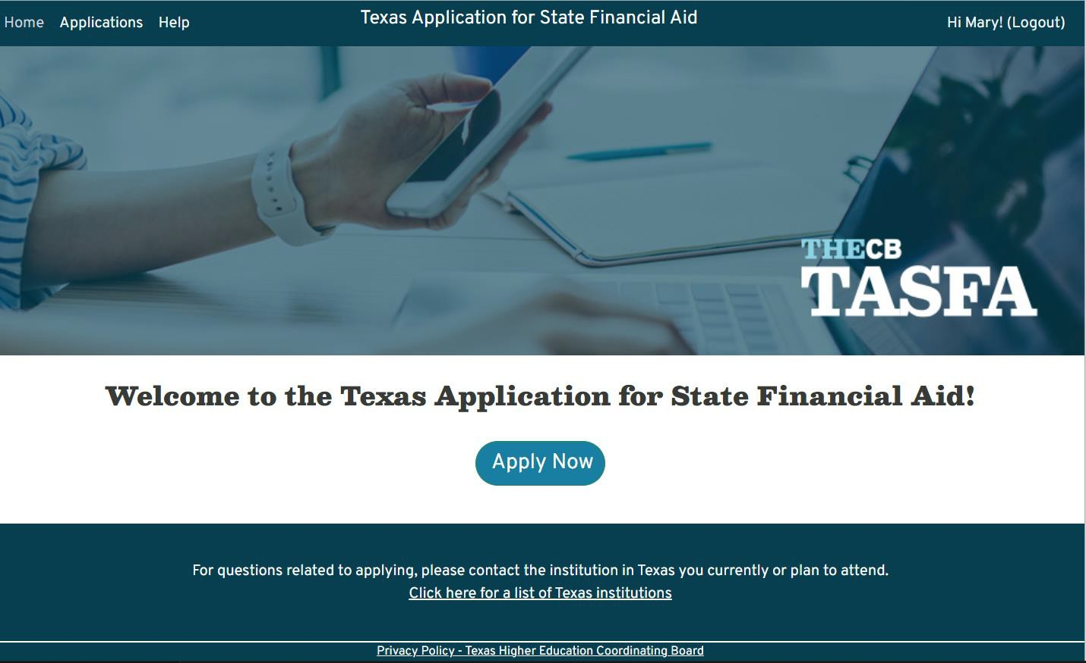
TASFA - Apply Now Page
29

Slide 9

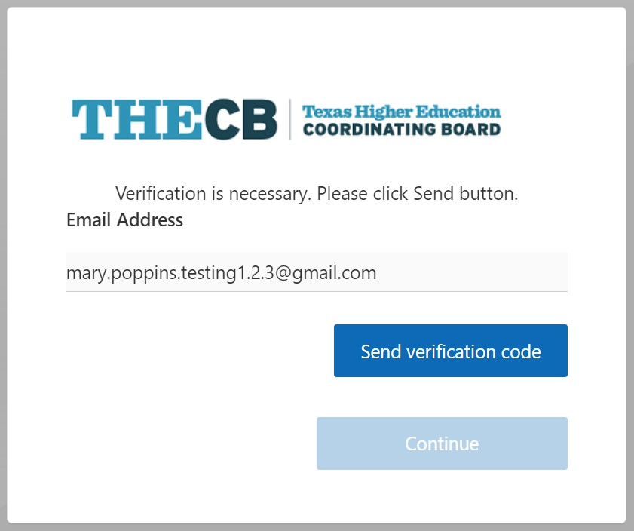
Returning User Log In
Returning users can log in using their
account:
A secure code will be sent to the
user’s email each time they access
TASFA to authenticate.

Slide 10


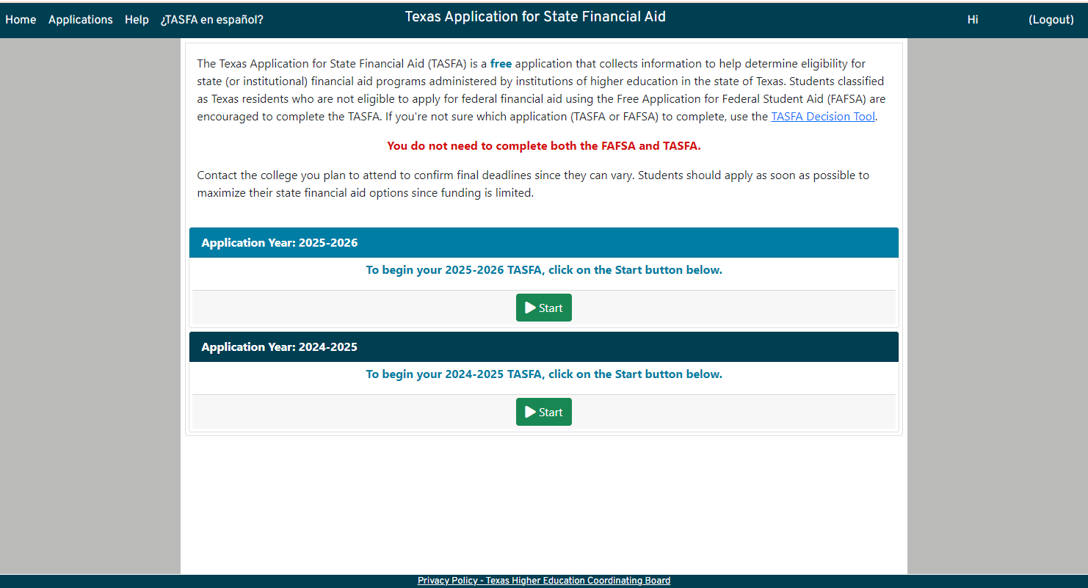
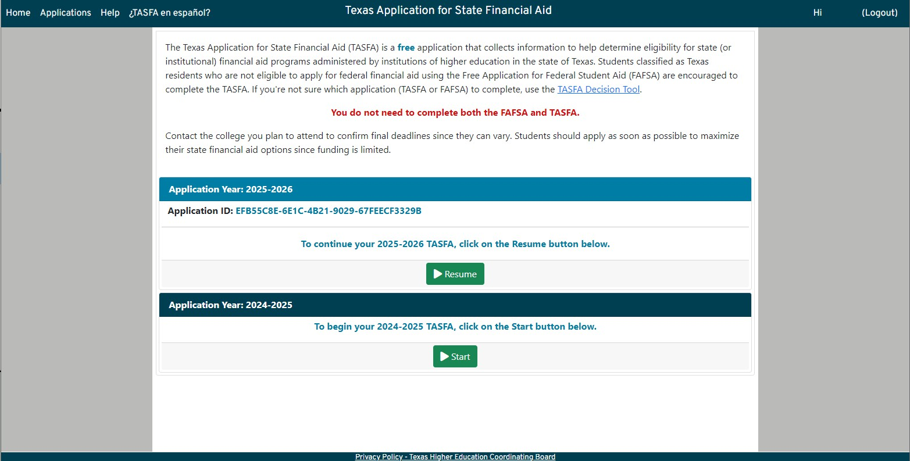
Applications Page
User will initially see a Start button.
Once information has been entered and saved, the button changes to Resume and applicant will be assigned an Application ID.
Once the application is submitted, the page includes a button to View Online Application or Submit to Additional Colleges.

Slide 11

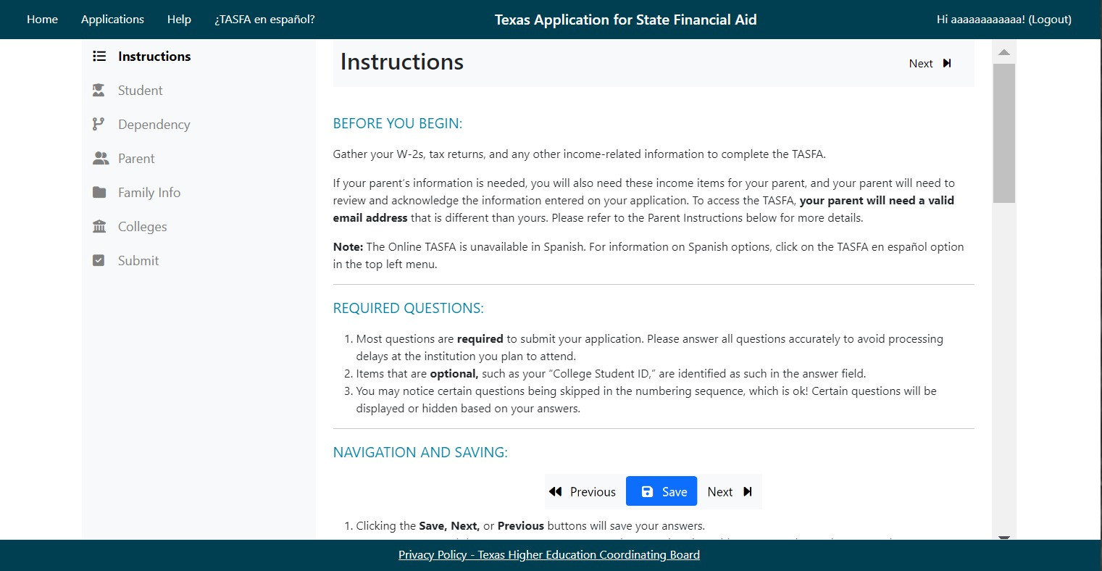
Application Menu
Highlights
Instructions are intended to help the user with application functionality while using the online form.
The student answers questions on the following sections:
Student
Dependency
Parent (if applicable)
Family Info
Colleges
Submit

Slide 12

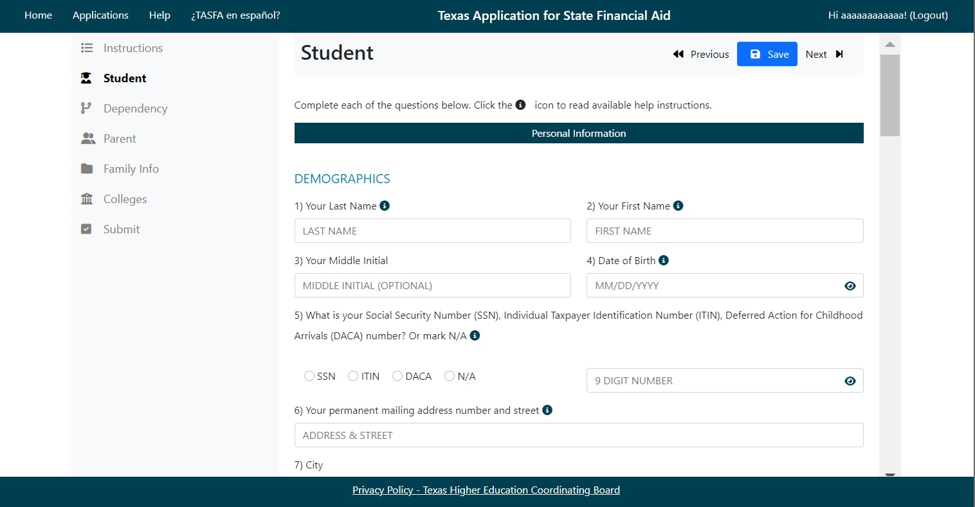
Student Section
Highlights
Student will complete:
  Personal Information
  Income and Assets
  Spouse Information (if applicable)

Slide 13

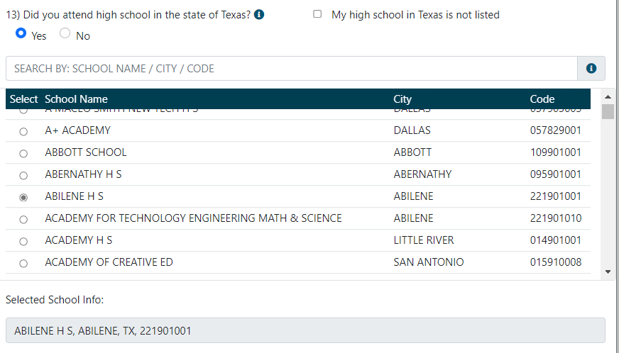
Student Section – High School
Highlights
If the student graduated in Texas, they can pick from the available high schools listed.
If their high school is not included, there is a manual entry option.
Manual entry is also required for students that attended high school outside of Texas.

Slide 14

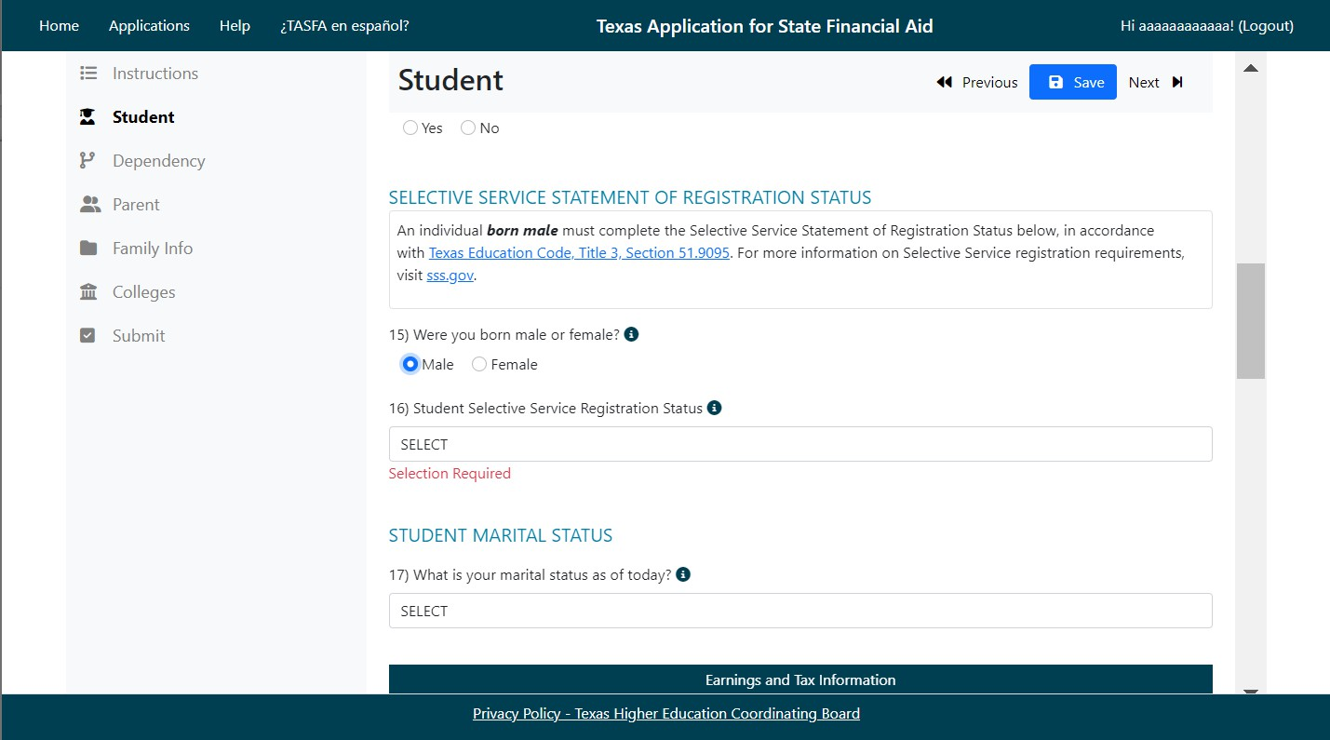

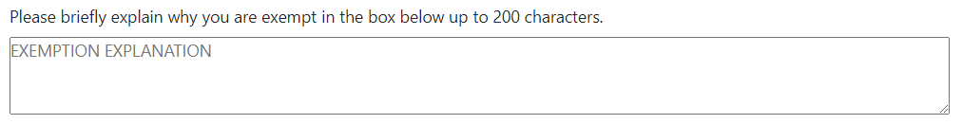
Student Section – Selective Service
Highlights
Male students are required to be registered or exempt for selective service to receive state aid.
An exemption box is available for the user to type in the reason.

Slide 15


Students can complete and mail a registration form which can be found at most post offices or at www.sss.gov.
Counselor Kayla wants to know, how do
students register for Selective Service if they cannot online?

Slide 16

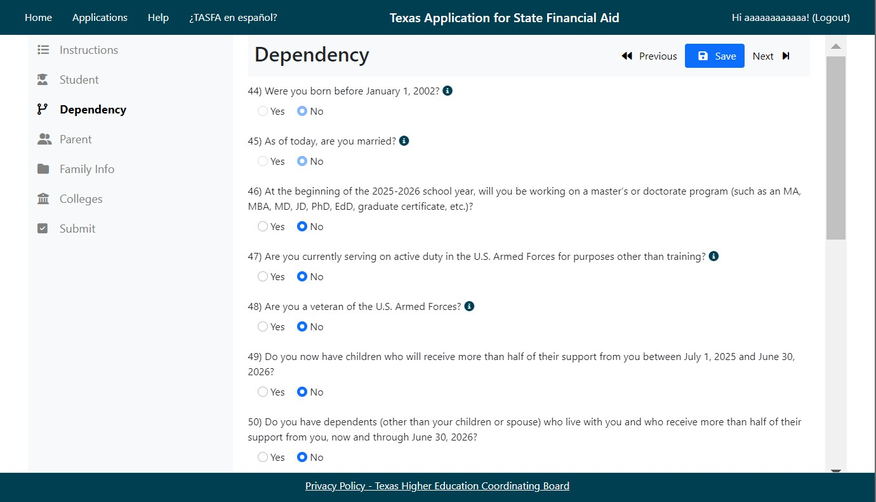
Dependency Section
Highlights
Depending on the response to marital status and
age, Parent 2 will appear or
stay hidden.
Parent tab will appear or disappear depending on the dependency responses.

Slide 17

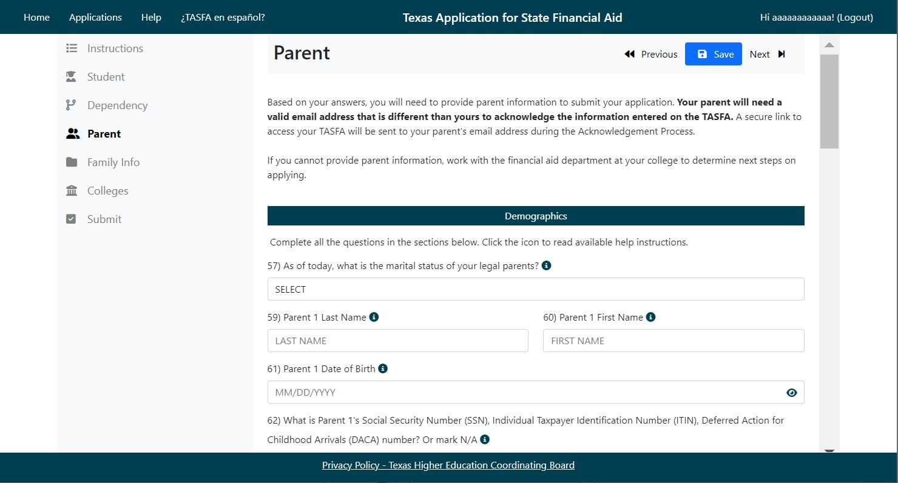
Parent Section
Highlights
Depending on the response to marital status and
age, Parent 2 will appear or
stay hidden.
Parent must have an email different than the student to access the TASFA to complete the required acknowledgement confirmation.

Slide 18

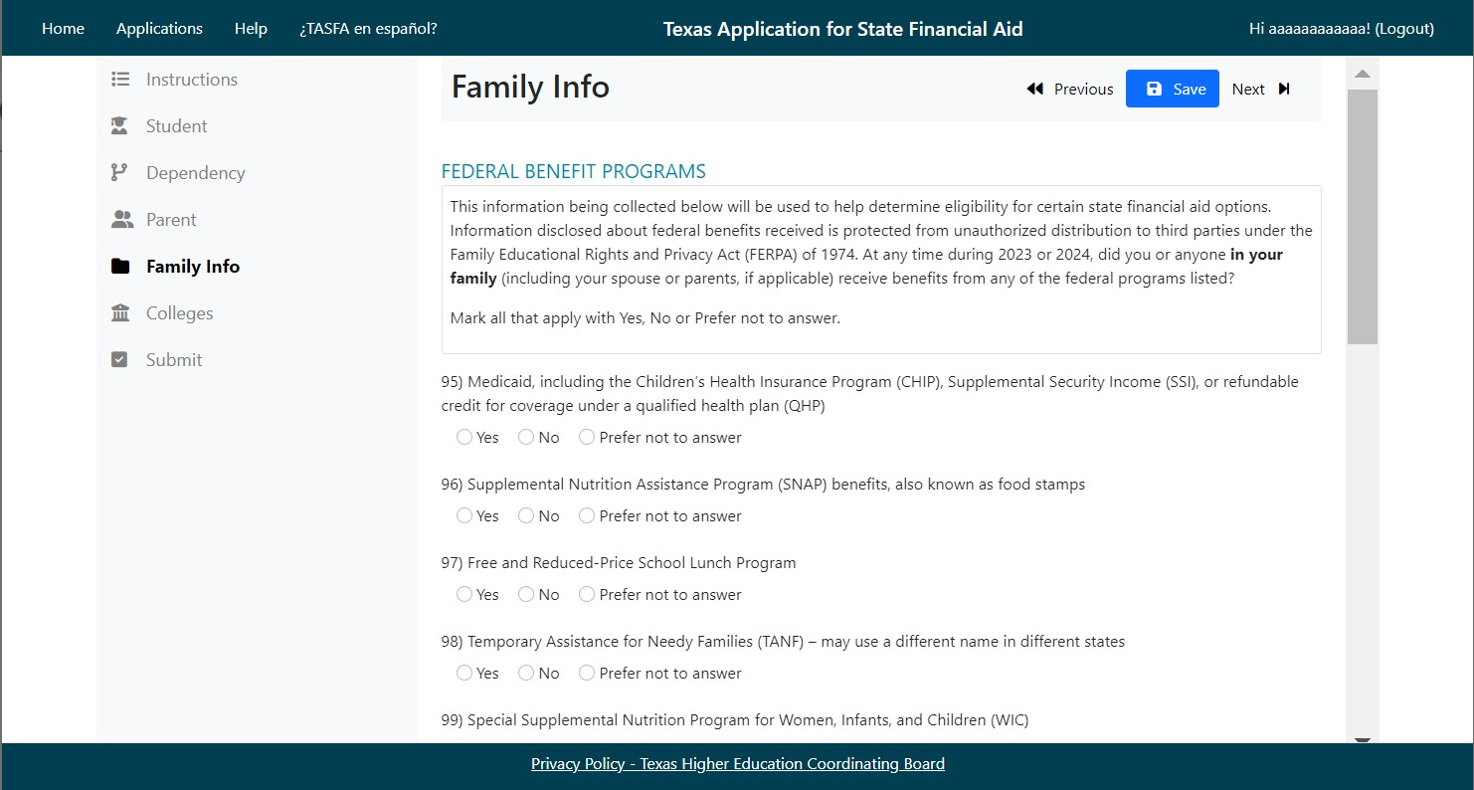
Family Info Section
Highlights
Student answers federal
benefit-related questions.
Student answers family size questions based on instructions for dependent and independent students.
Footer text

Slide 19
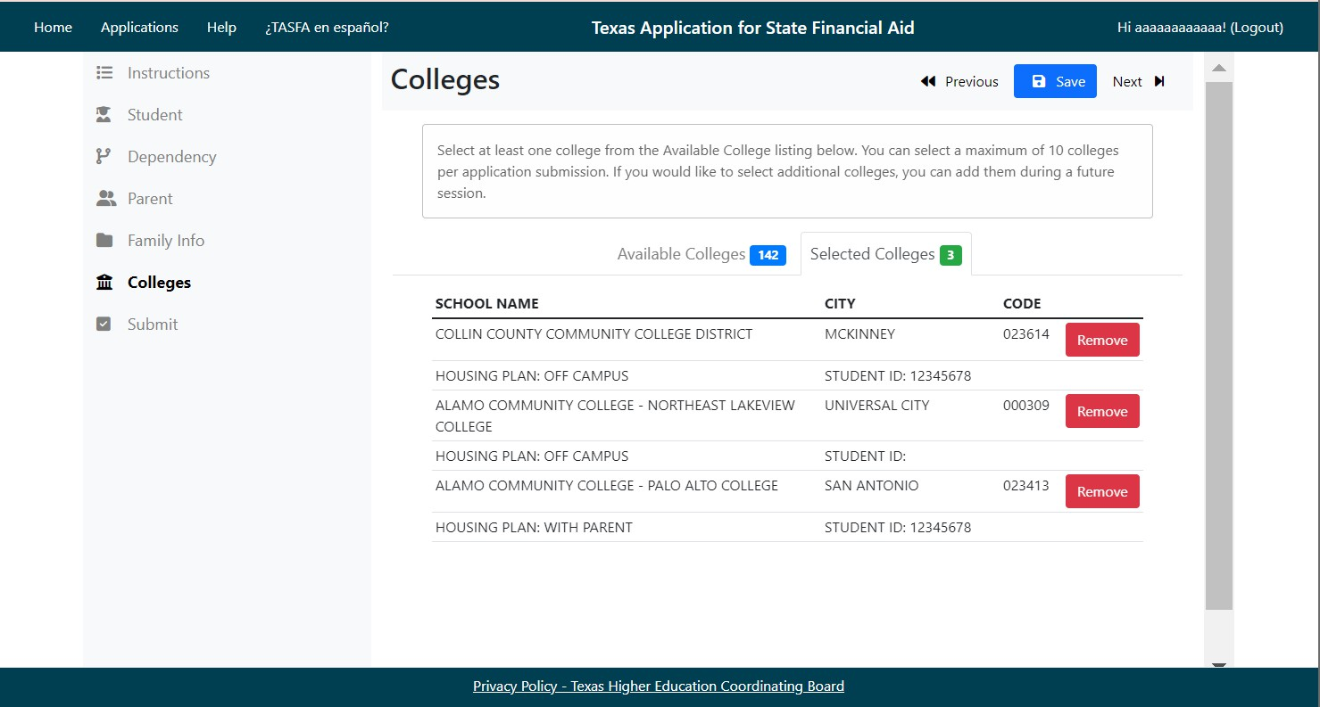
College Section
Highlights
Available colleges listing will be updated as they are selected.
User can remove colleges prior to submission by clicking the Selected Colleges tab.
User can add up to 10 colleges per submission.
  Housing status is required.
  College Student ID is
optional.

Slide 20

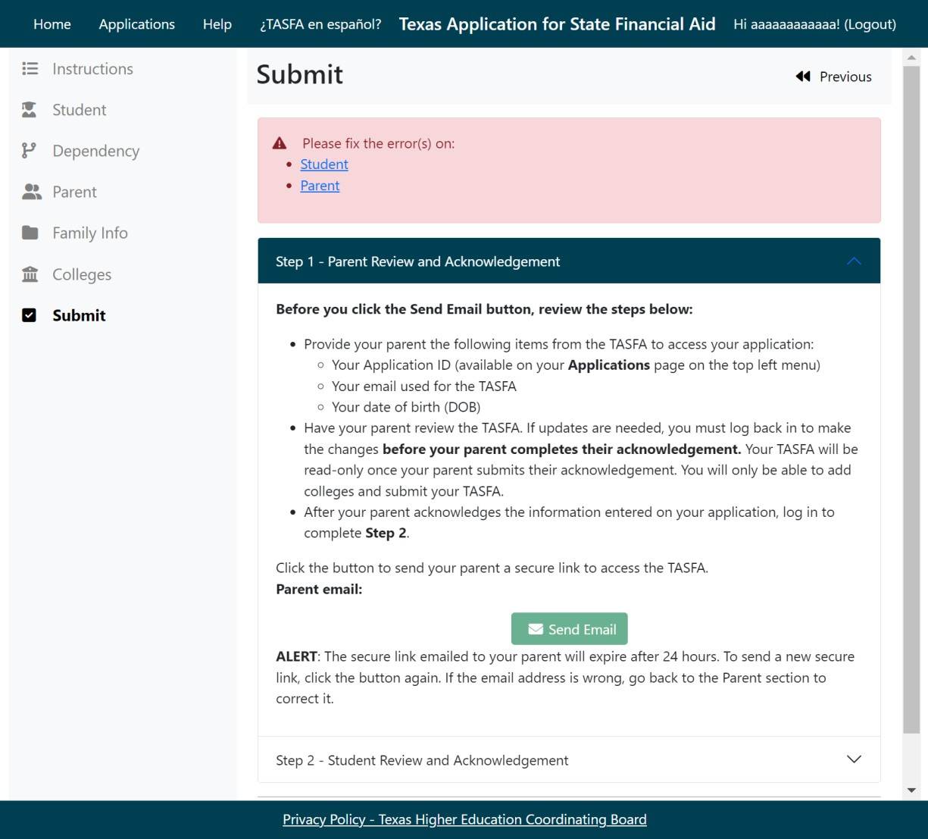
Submit Section
Highlights
Incomplete sections will show on a banner with hyperlinks to the applicable pages.

Slide 21


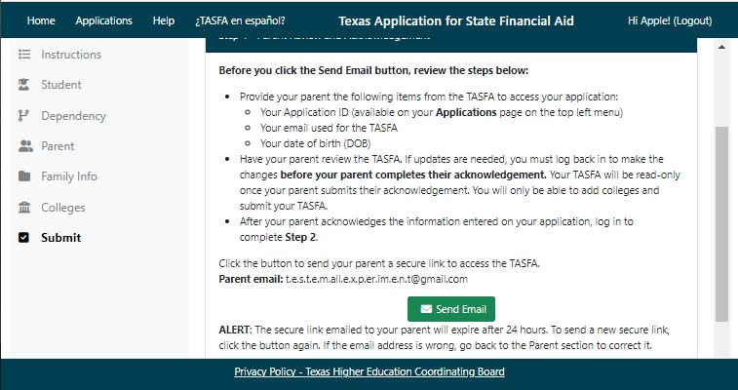
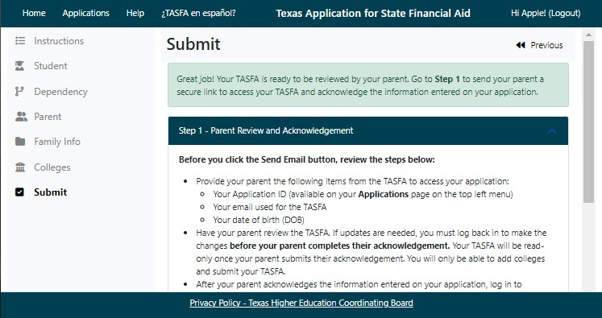
Parent Acknowledgement Process
Highlights
Once all fields are complete and validated, the student can send their parent a secure link via email to access the application.
Link is good for 24 hours and user can send additional links until the TASFA is submitted.

Slide 22


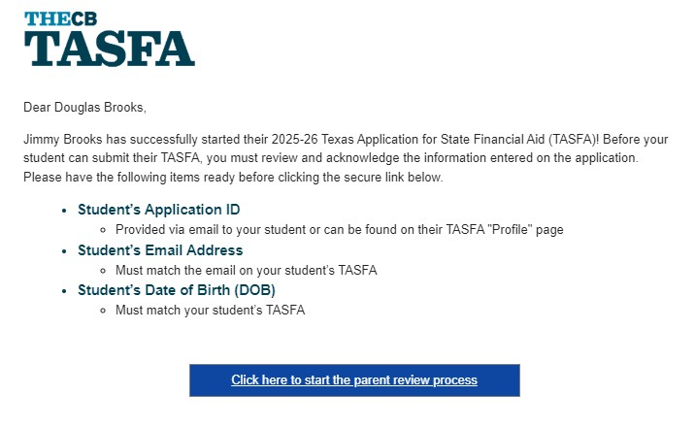
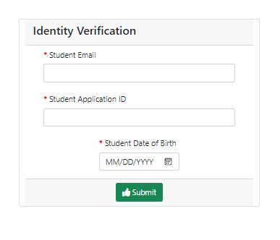
Parent Access Link
Highlights
Parent clicks on the link in the email to launch a new browser and must enter three specific student validation items to access the application.

Slide 23

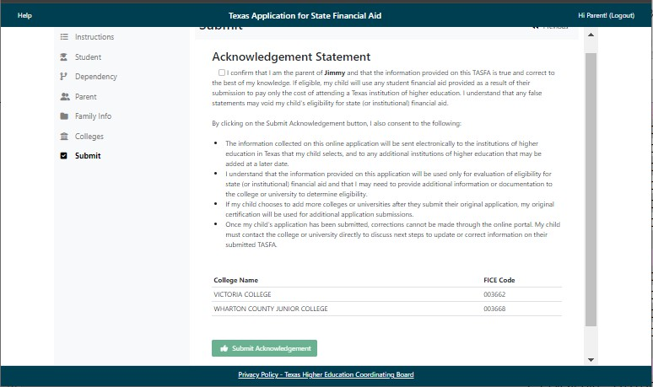

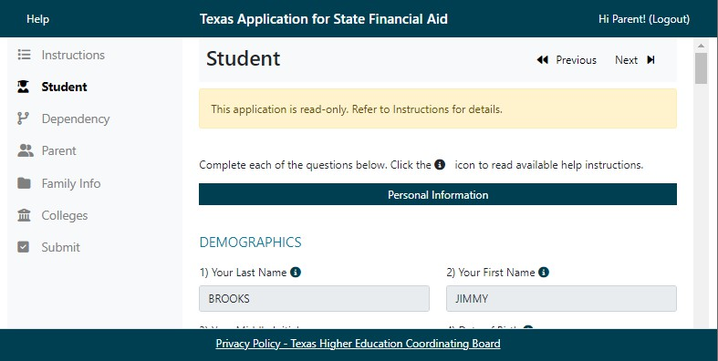
Parent Acknowledgment
Highlights
Parent will have read-only access.
Once they have reviewed the application, they go to the Submit section.
Parent will click Acknowledgement Statement box, then click the green Submit button.

Slide 24

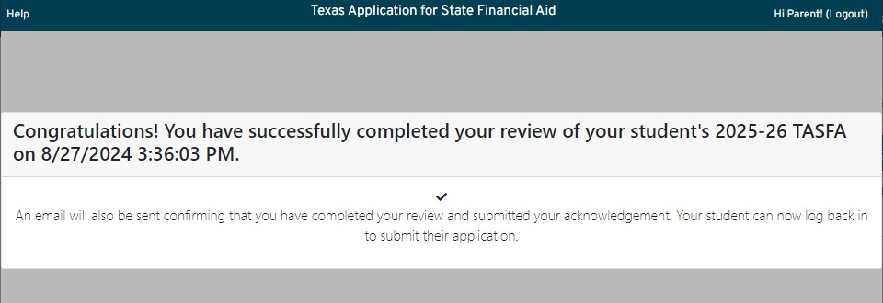
Parent Acknowledgment
Highlights
Parent will have read-only access.
Once they have reviewed the application, they go to the Submit section.
Parent will click Acknowledgement Statement box, then click the green Submit button.
Page will pop up with a confirmation
message.

Slide 25

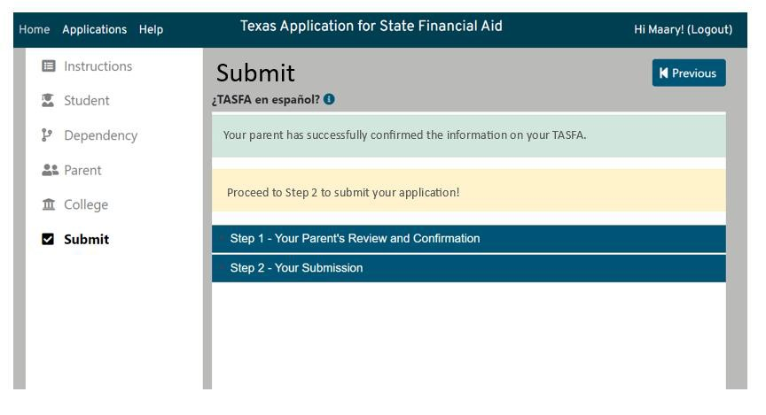
Dependent Student Submission

Slide 26

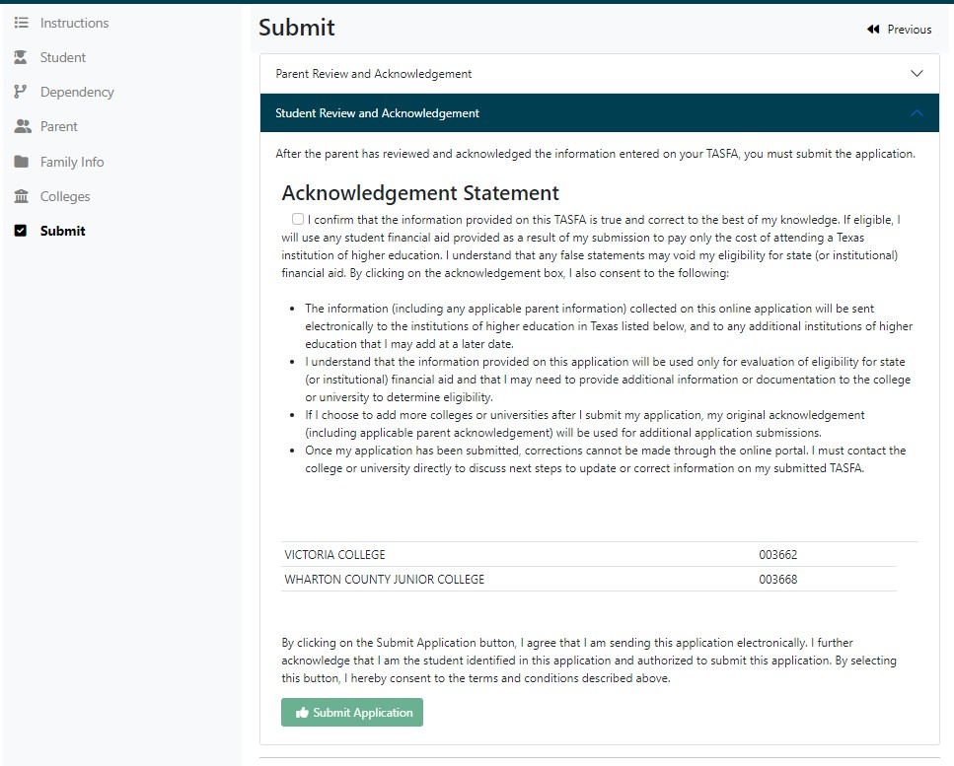
Dependent Student Submission
Student will review colleges and then click Acknowledgement Statement box, then click the green Submit Application button.

Slide 27


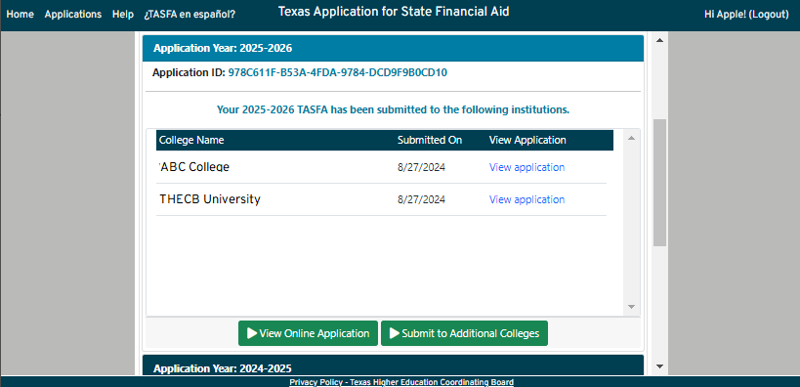
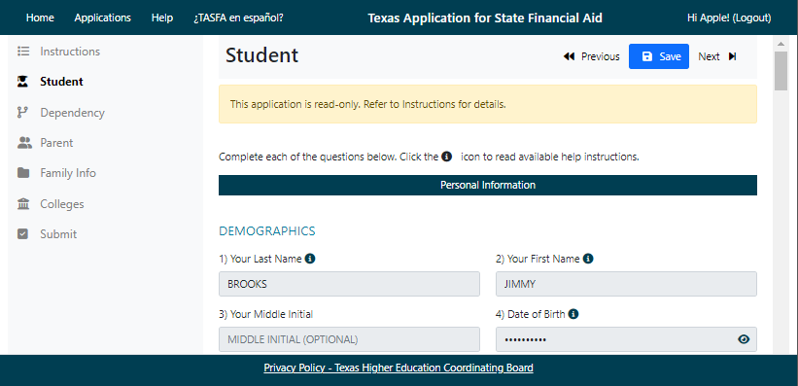
View Application
Highlights
Student can go to the Applications page to:
  View their submitted TASFA in a read-only format.

Slide 28

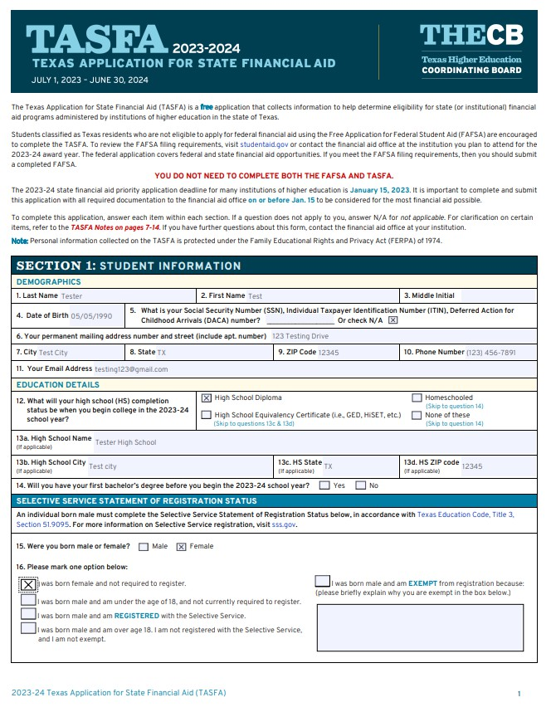

Printable Copy
Highlights
Student can go to the Applications page to:
  View their submitted TASFA in a read-only format.
  View the date submitted or print a copy of their submitted TASFA (by school) in PDF format.

Slide 29

Add Colleges
Highlights
Student can go to the Applications page to:
  View their submitted TASFA in a read-only format.
  View the date submitted or print a copy of their submitted TASFA (by school) in PDF format.
  Add up to 10 colleges per submission.

Slide 30
Additional Guidance
Contact THECB
Contact Institution
Technical issues completing online TASFA
General questions on application
Account access issues
Question about THECB webpage
Next steps after TASFA has been submitted
Details on required documentation
Complex questions on filling out the TASFA
Call 1-888-311-8881 or
submit a Contact Us inquiry
(select “Financial Aid Question” as the Contact Reason)

Slide 31
What if a dependent student cannot provide parent information on TASFA?
The Online TASFA currently does not have a way for a dependent student to
bypass providing parent information.
The student would need to reach out to the financial aid office in these specific circumstances.

Slide 32
What if the student has two parents that are married or living together?
Both parents’ information will be needed on the TASFA.
Parent 1 will need to acknowledge the information entered on the application for the student to submit.

Slide 33
What if the student has two parents that are divorced or not living together and not remarried?
The parent that supports the student the most financially over the 12- month period before the TASFA is submitted will need to report their information on the TASFA as Parent 1.

Slide 34
What if the student has two parents that are divorced or not living together and one or both remarried?
The parent that provides the most financial support over the 12-month period before the TASFA is submitted will need to report their information on the TASFA as Parent 1.
If the parent that provides the most financial support to the student is remarried, then the stepparent will need to report their information on the TASFA as Parent 2.

Slide 35
What if the student lives with a guardian or relatives and their parents live in another country?
Unless the guardian or relative has legally adopted the student, the guardian or relative should not put their information on the TASFA.
The parent's or parents' information will still be needed on the TASFA.
The student will not be able to continue filling out the online TASFA without the parent information and may have to reach out to the college on their circumstance.

Slide 36
Online TASFA vs Online FAFSA
Unlike the FAFSA, the Online TASFA:
Cannot pull IRS tax information like the FAFSA, and students will need to follow up with the financial aid office on documentation.
Will not have upload ability for tax or other documents.
Cannot copy over prior application information for the student like the FAFSA, but the student can use the same account and email.
Does not calculate a Student Aid Index or estimate financial aid eligibility like the FAFSA. It is only a pass-through of information to the selected college.
Will not be available in Spanish for 2025-26 but will have a paper TASFA linked and available in Spanish.
However, the online TASFA will continue to improve and develop over time.

